Slide 1
Application of Linear Algebra in Quantum Computing
Tanvi Penumudy
(E18CSE187)

Slide 2
Quantum Computing
Quantum Computing is an area of computing focused on developing computer technology governed by the laws of Quantum Mechanics*.
A Quantum Computer uses ‘Qubits’.
A quantum computation consists of a sequence of operations performed on quantum states.
The operations and states can be represented by matrices and vectors, respectively, and are required by the underlying physics (Quantum Mechanics) to follow the rules of Linear Algebra.
*It is a branch of physics dealing with the behaviour of matter and light at a subatomic level that are subject to the uncertainty
principle.

Slide 3
Uses of Quantum Computing
Quantum Computing

Slide 4
Why Quantum Computing?
Quantum Computing

Slide 5
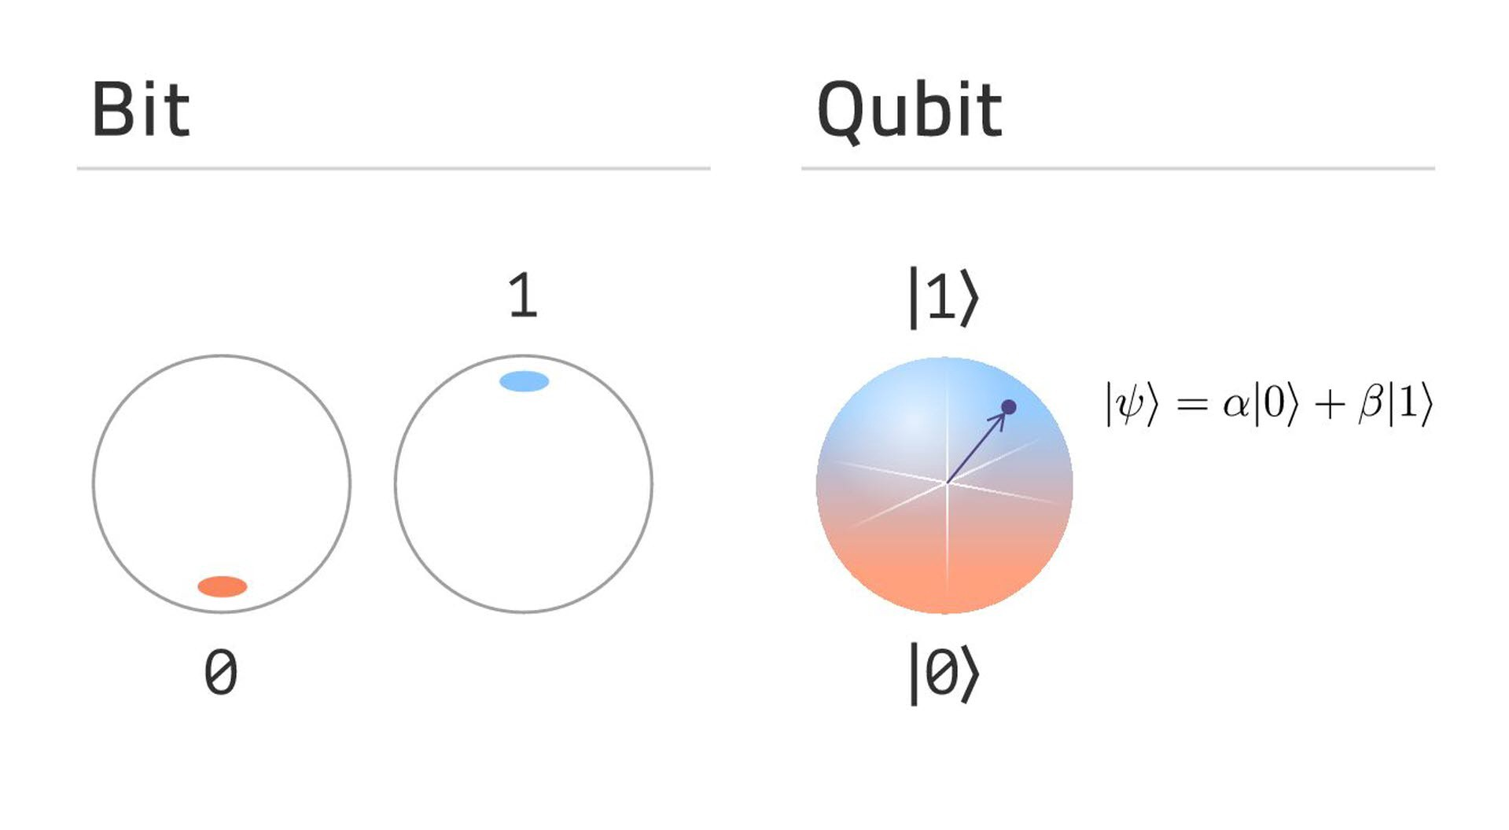
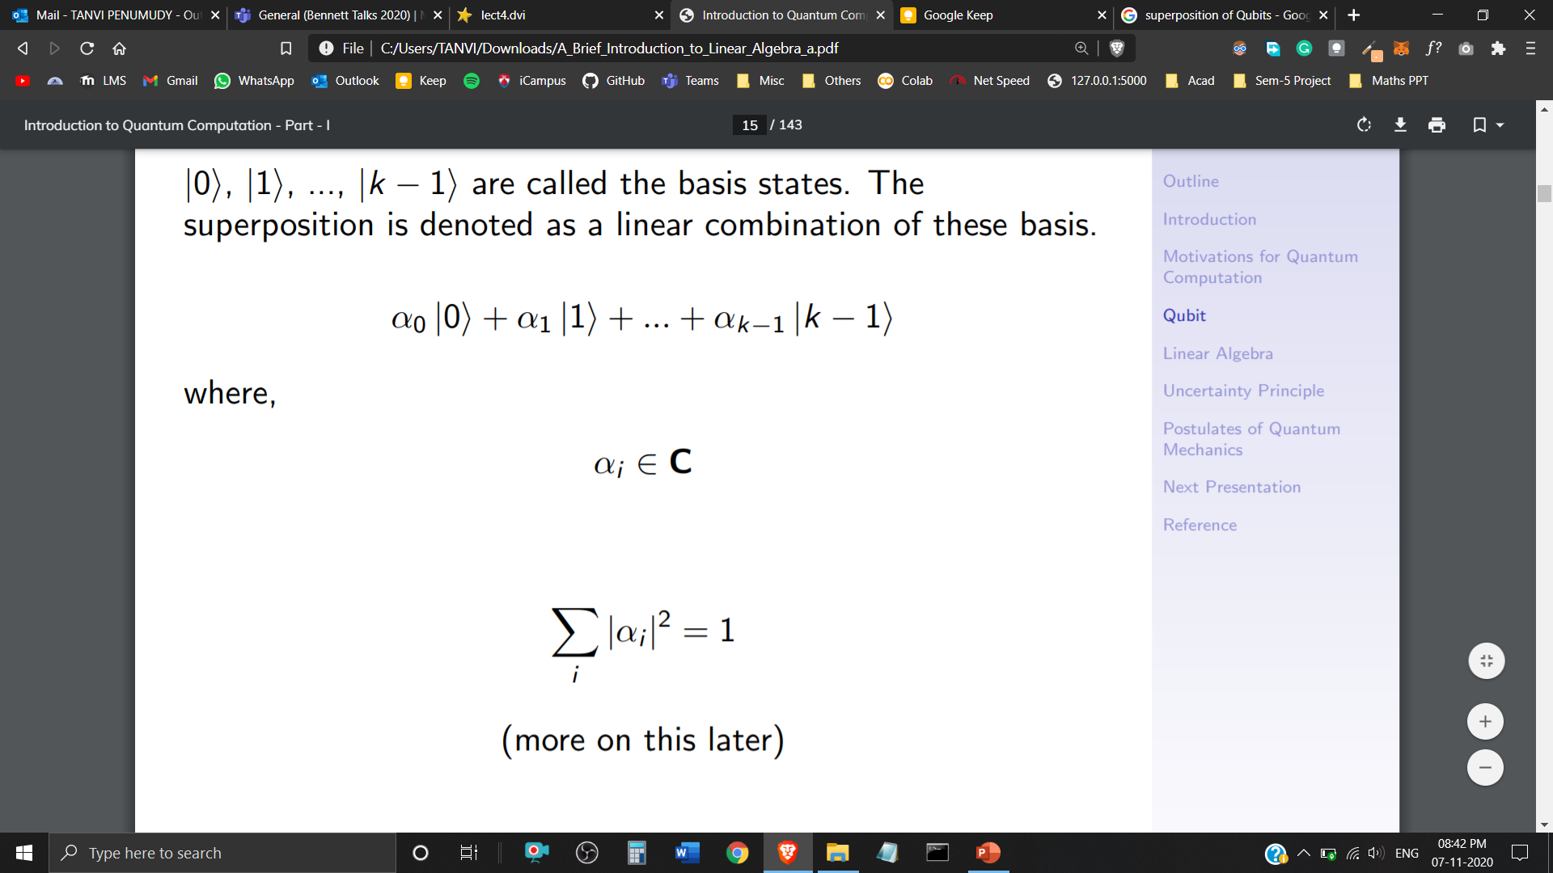
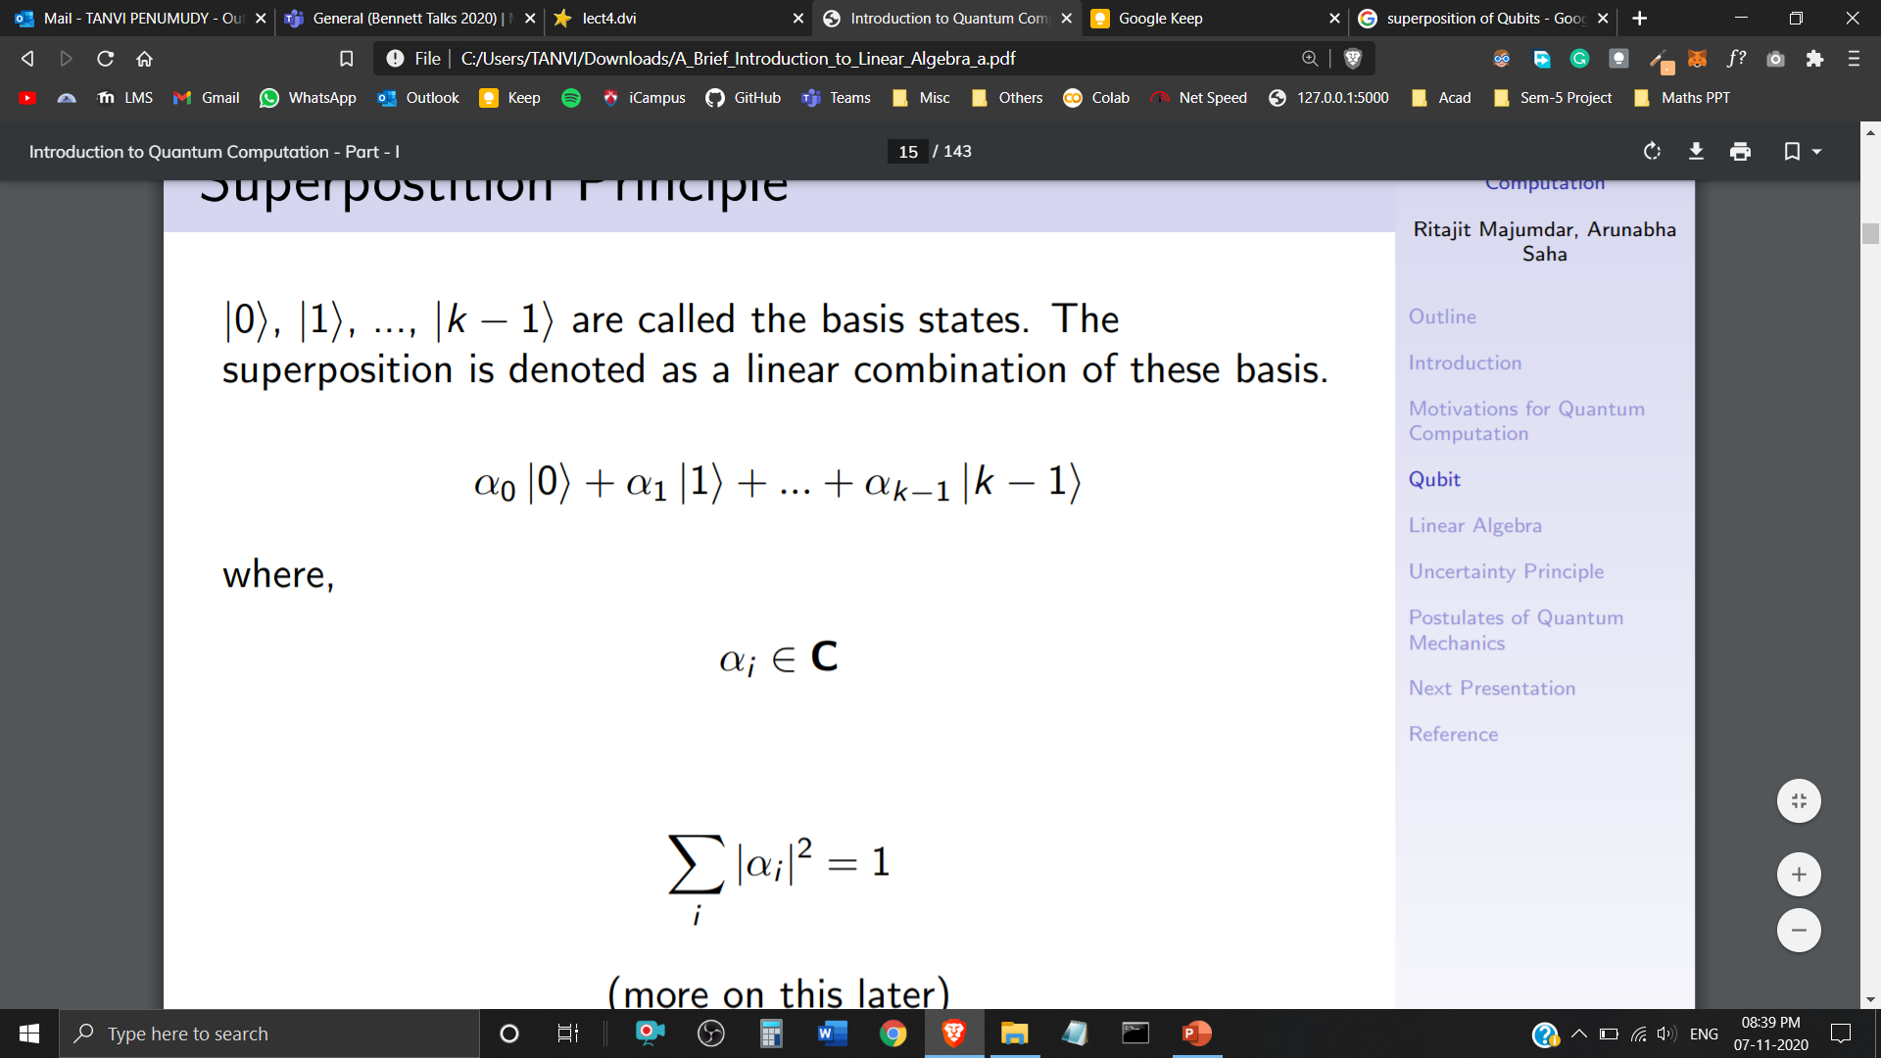
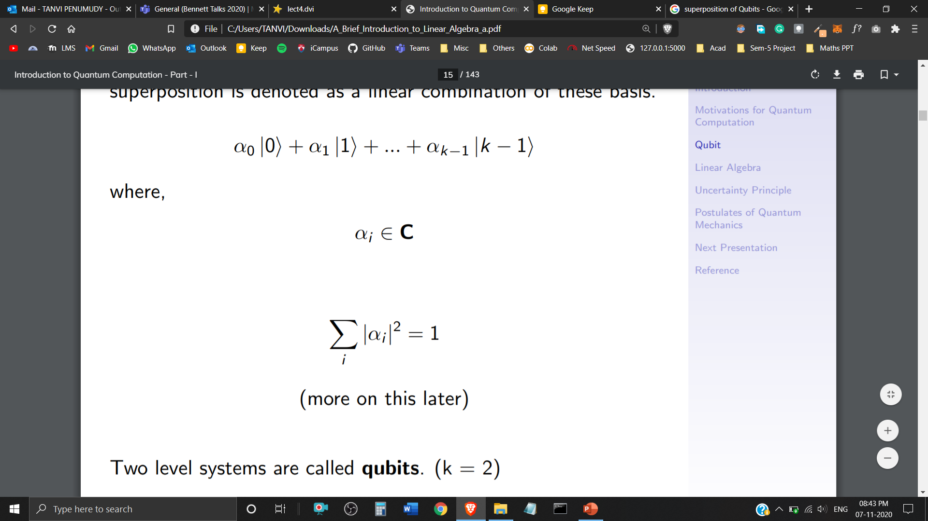

Superposition
In classical computation, bits are either represented with 0 or 1.
In Quantum Computation, these bits are replaced by a superposition of both 0 and 1.
If a quantum system can be in one of k states, it can also be in any linear superposition of those k states.
Two level systems are called Qubits (k=2)
are called the basis states, the superposition is denoted as a linear combination of these basis.
where, and

Slide 6
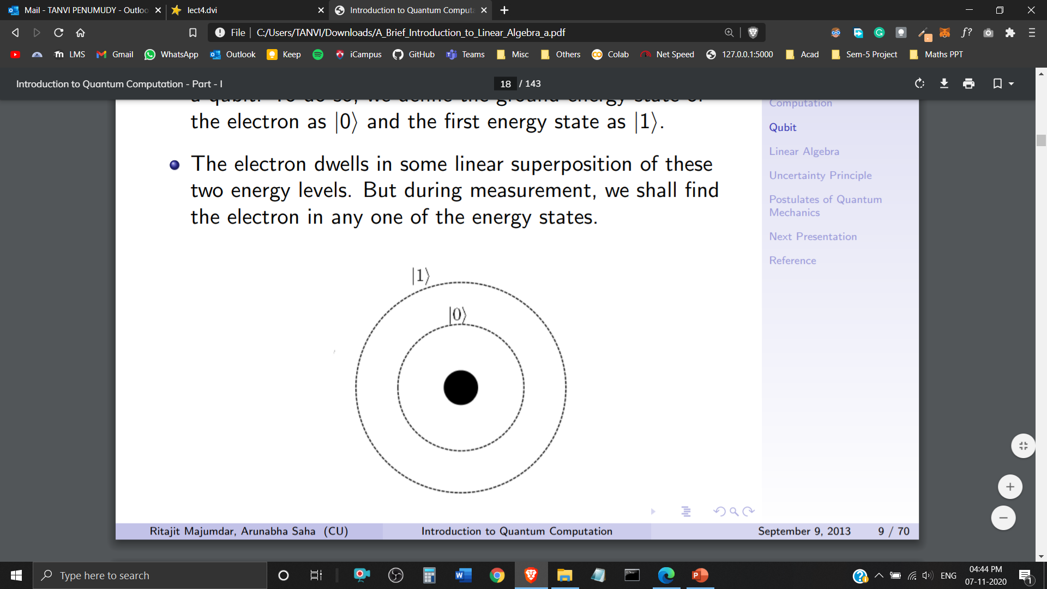
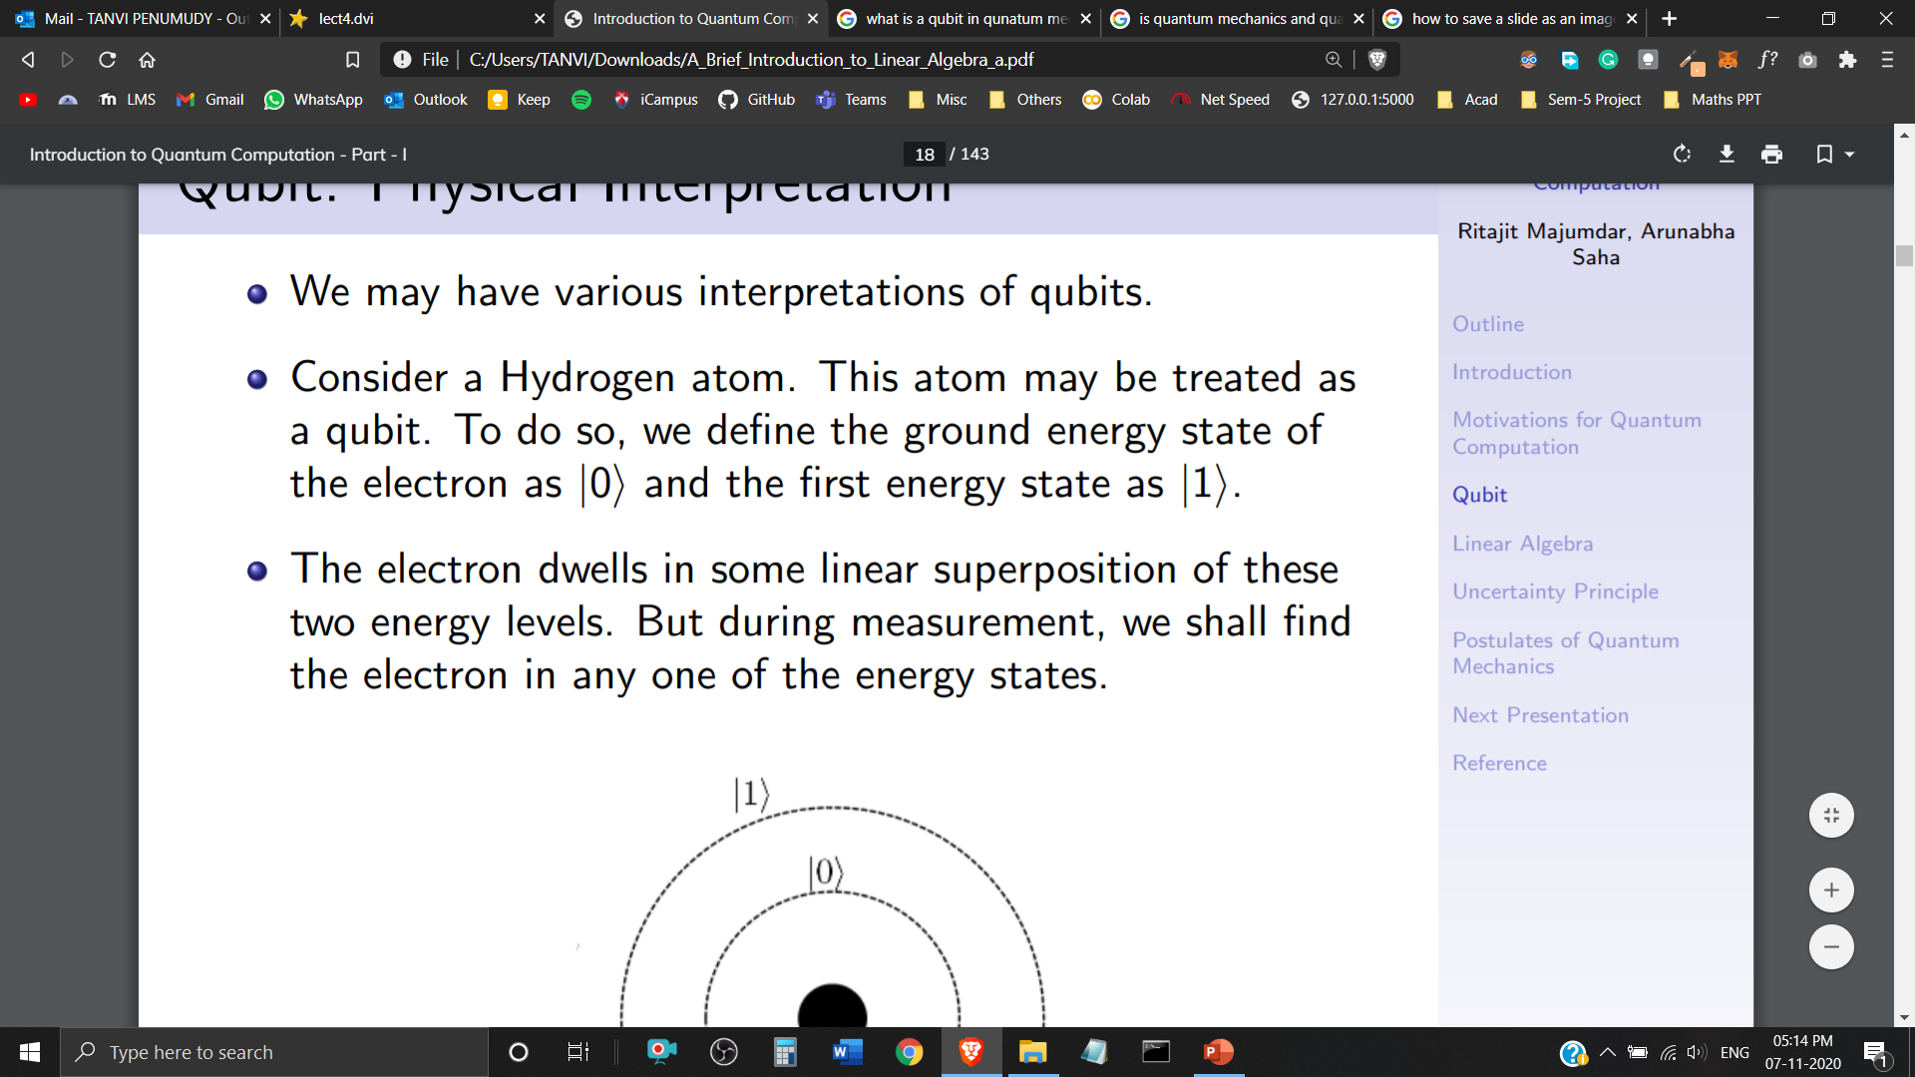
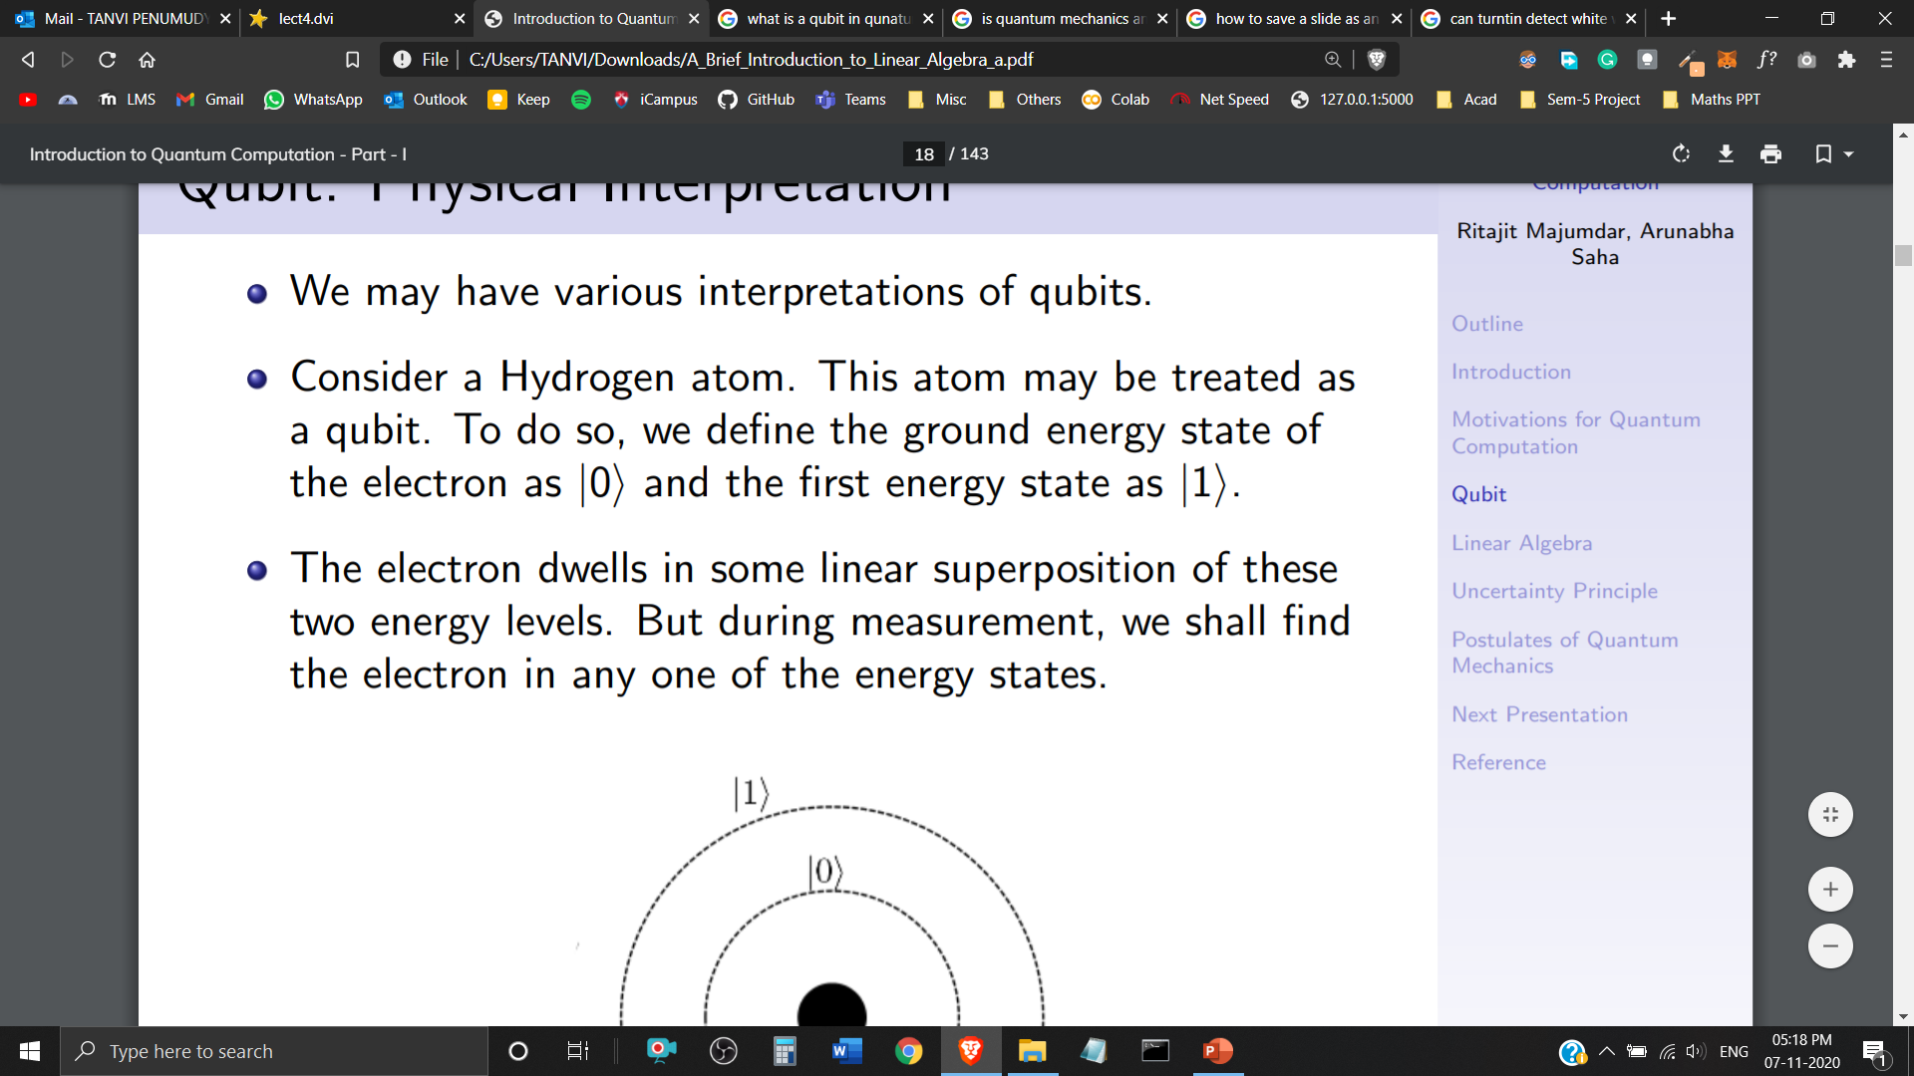
Qubits
A Quantum Bit or a ‘Qubit’ is a building block or a basic unit of Quantum Information.
We have various physical interpretations of a Qubit in Quantum Mechanics.
A Hydrogen atom could be interpreted as a Qubit. An electron in its ground state, could be represented as and in its first energy state as .
The electron dwells in some linear superposition of these two energy levels. But during measurement, it can only be found in one of these energy states.
Hydrogen Atom

Slide 7
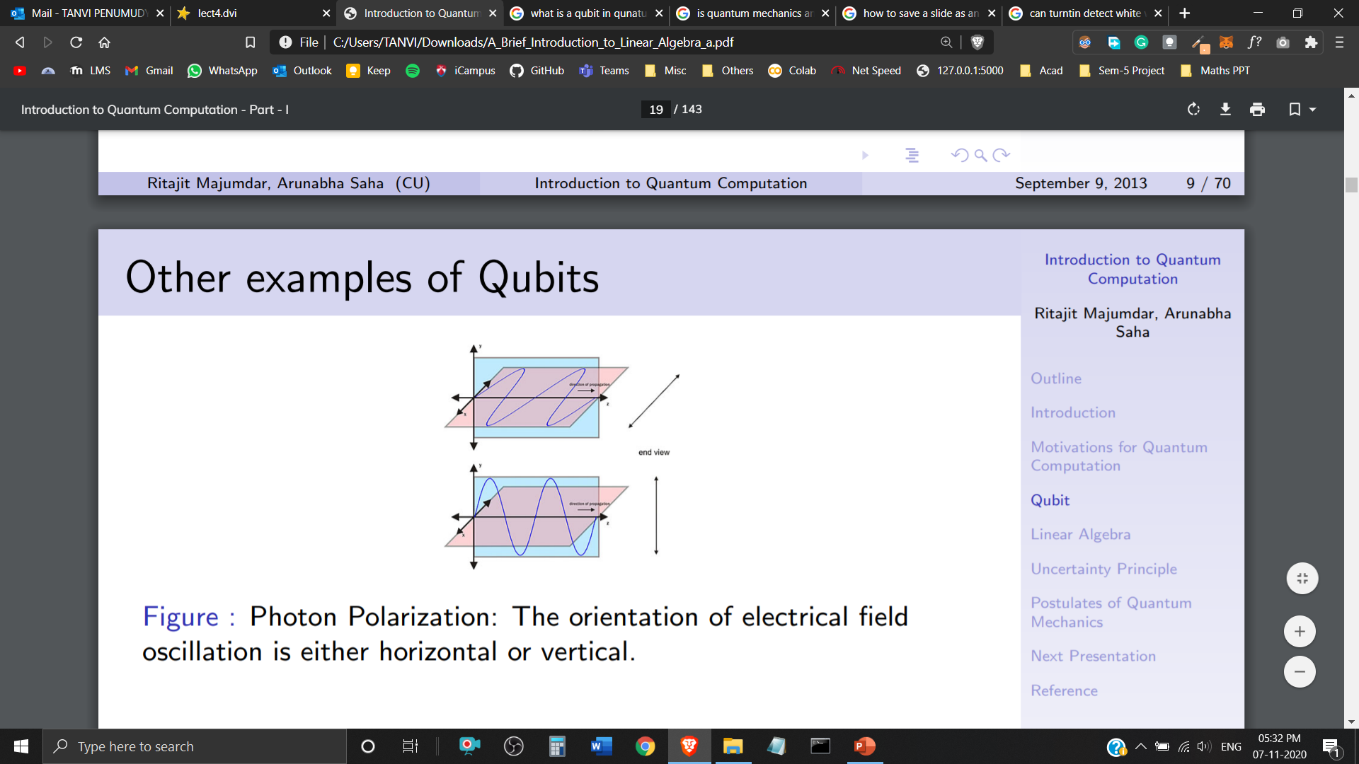
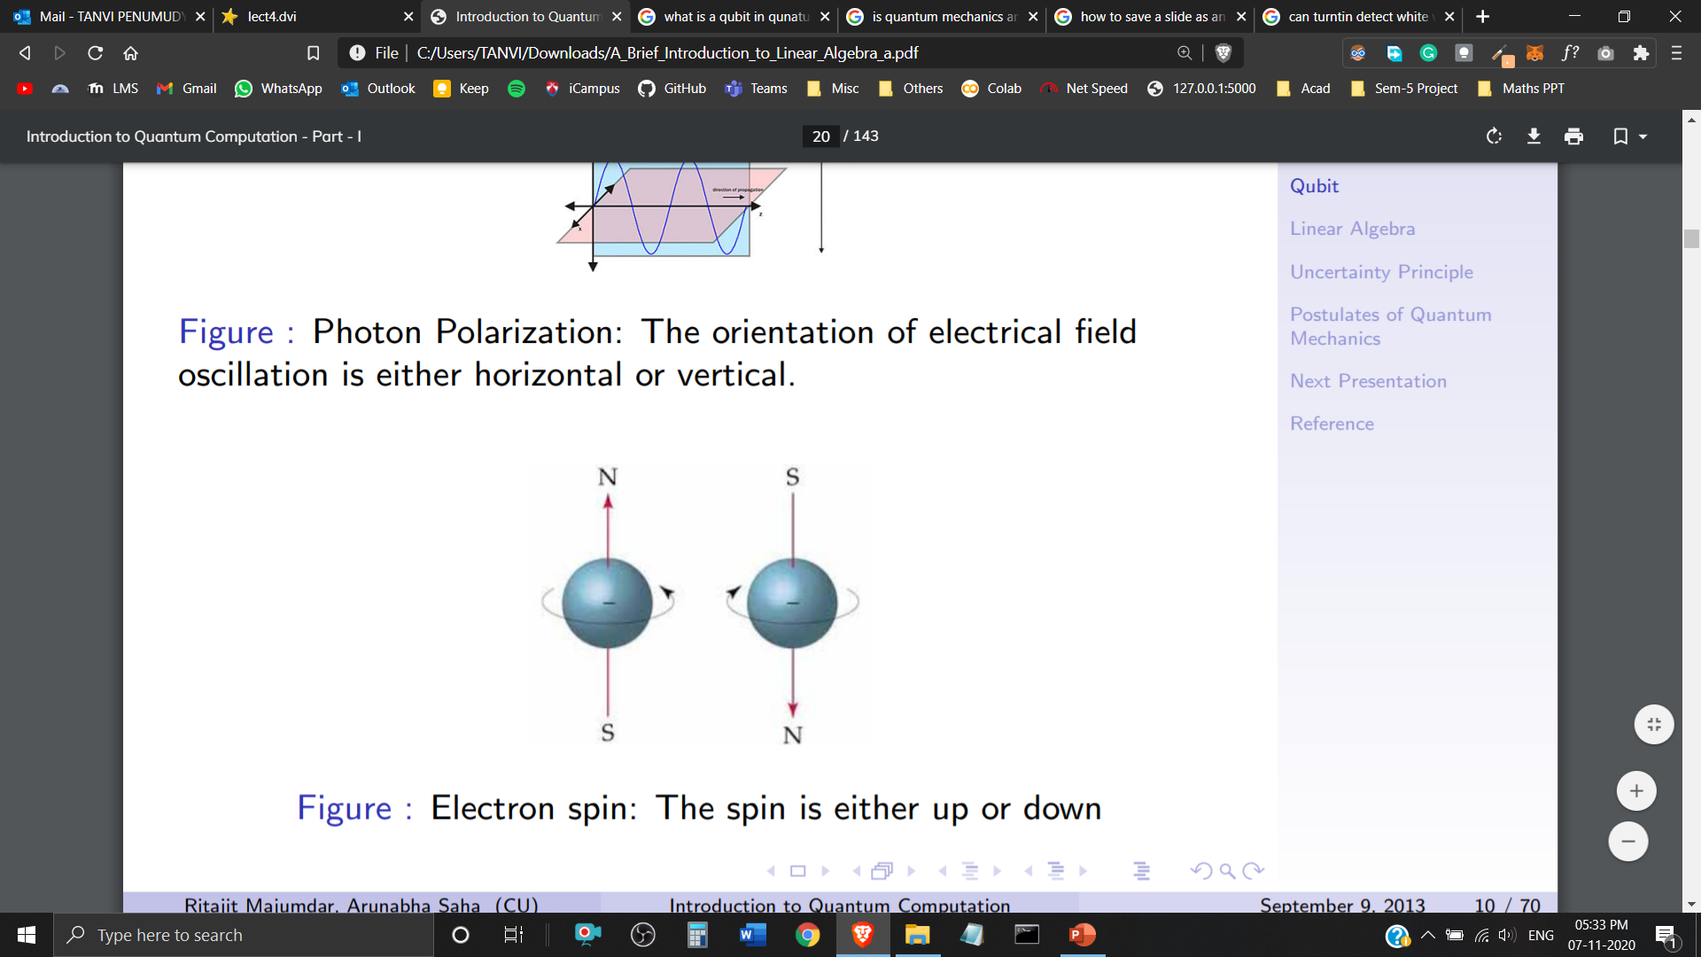
Examples of Qubits
Photon Polarization: The orientation of electrical field oscillation is either horizontal or vertical.
Electron Spin: The electron spin is either up or down.

Slide 8
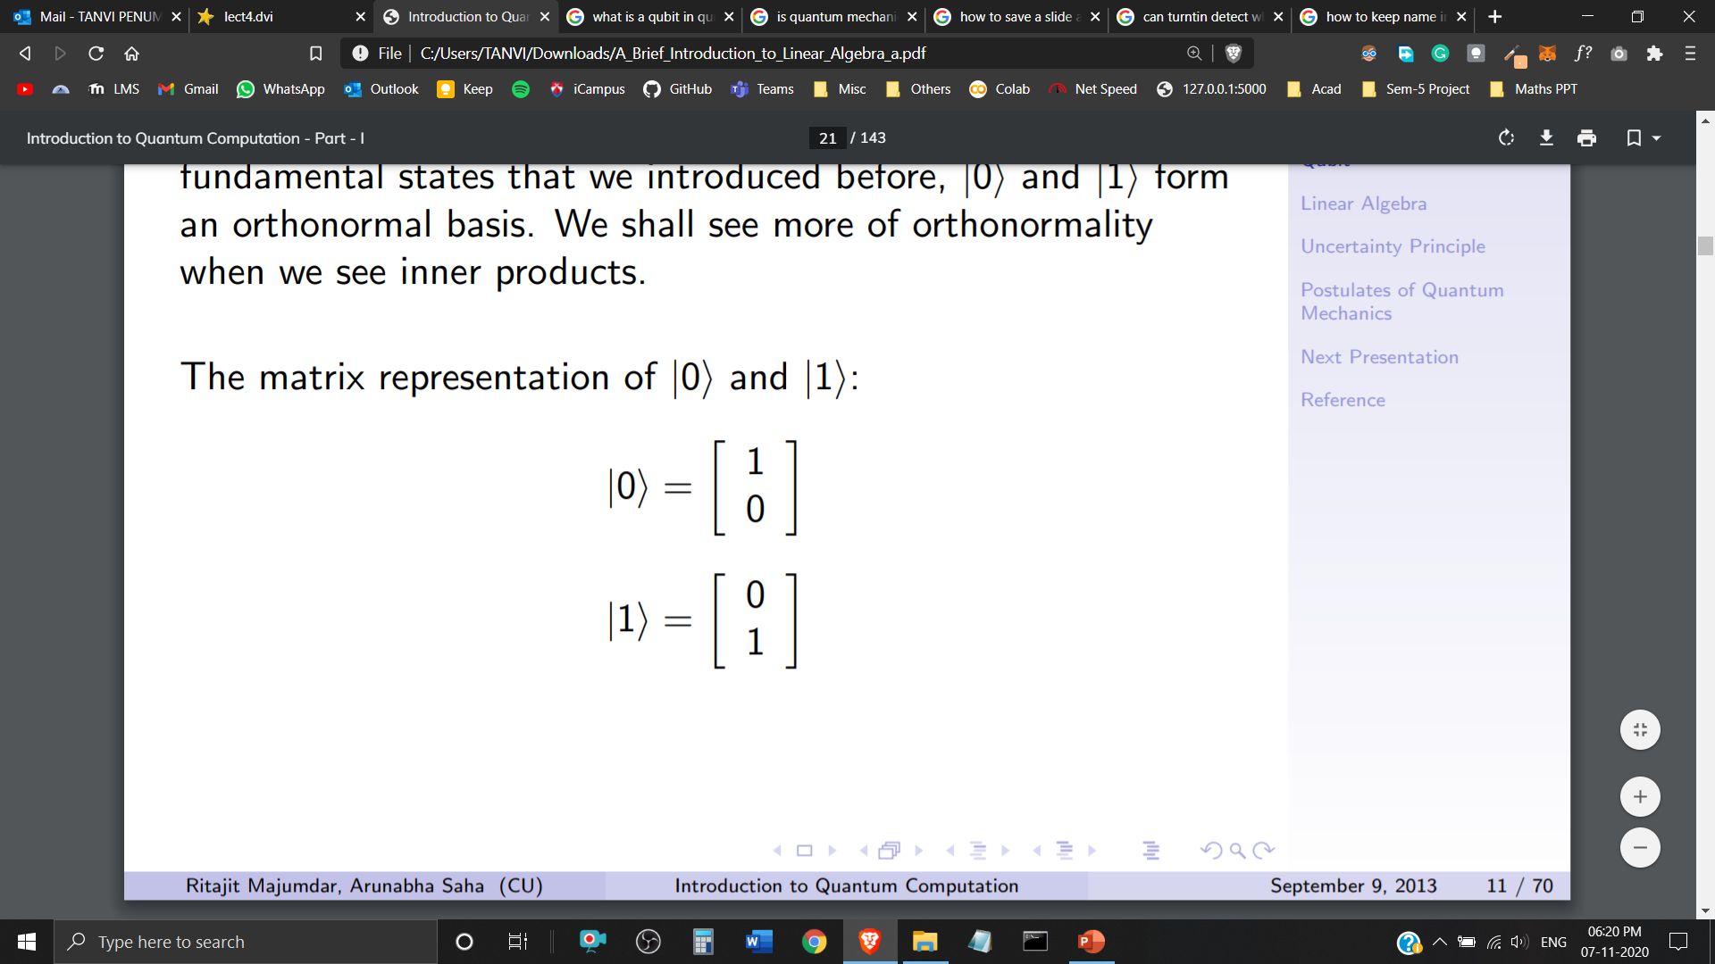
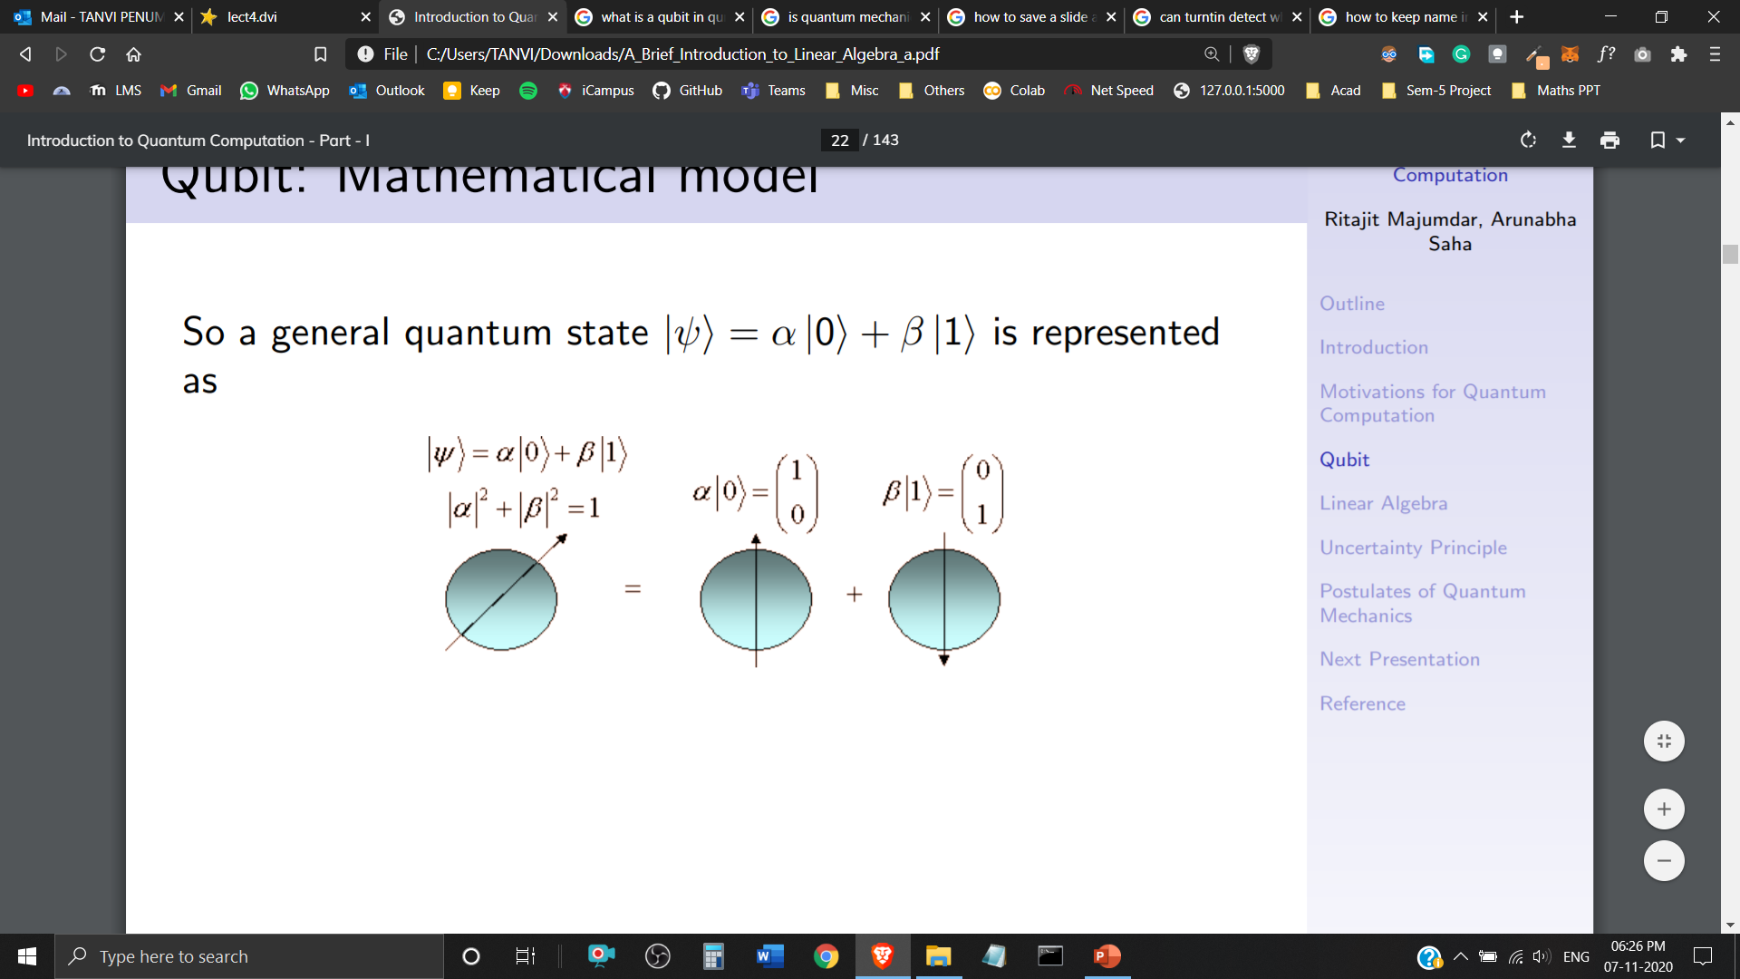
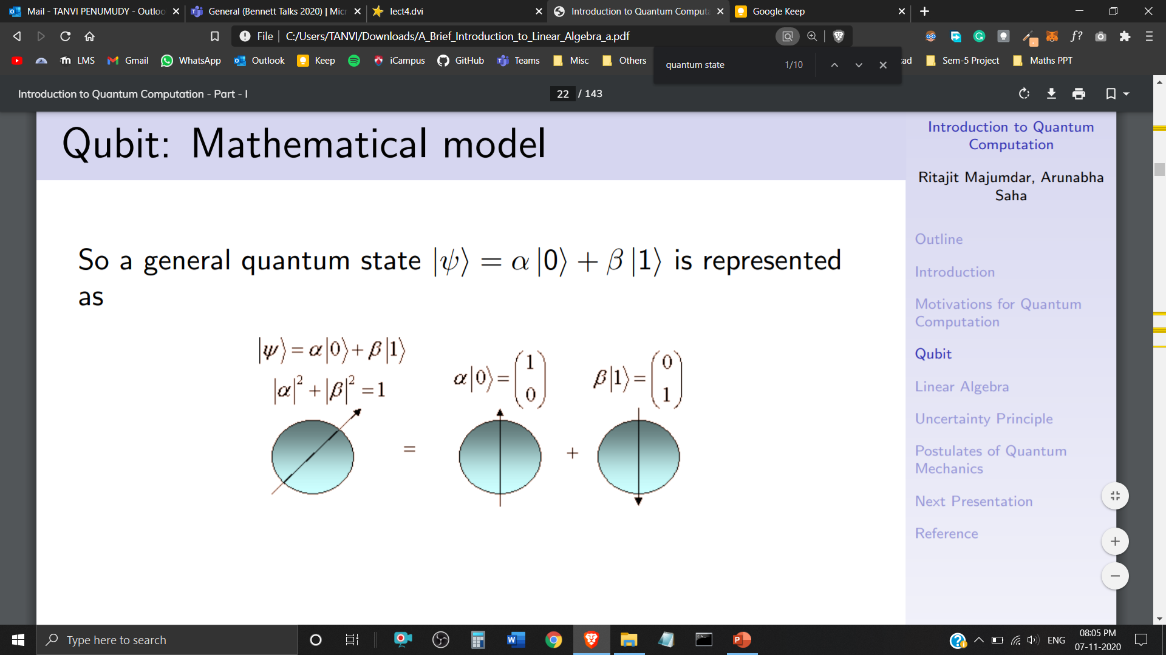
Representation of Qubits
Matrix Representation of and
Representation of a General Quantum State:

Slide 9
Imagine to have 500 qubits, then 2⁵⁰⁰ complex coefficients describe their state.
How to store this state?
2⁵⁰⁰ is larger than the number of atoms in the universe.
It is impossible in classical bits.
This is also why it is hard to simulate quantum systems on classical computers.
A quantum computer would be much more efficient than a classical computer at simulating quantum systems.
Superposition and Entanglement are what give quantum computers the ability to process so much more information so much faster.

Slide 10
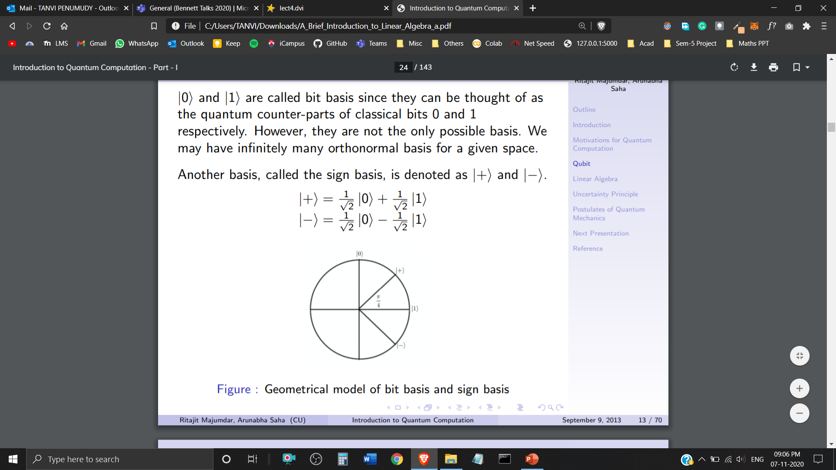
Sign Basis
and are called the bit basis. However, they aren’t the only possible basis.
We can have infinitely many orthonormal basis for a given space.
Another basis, called the sign basis is denoted as and
Geometrical Representation of Basis

Slide 11
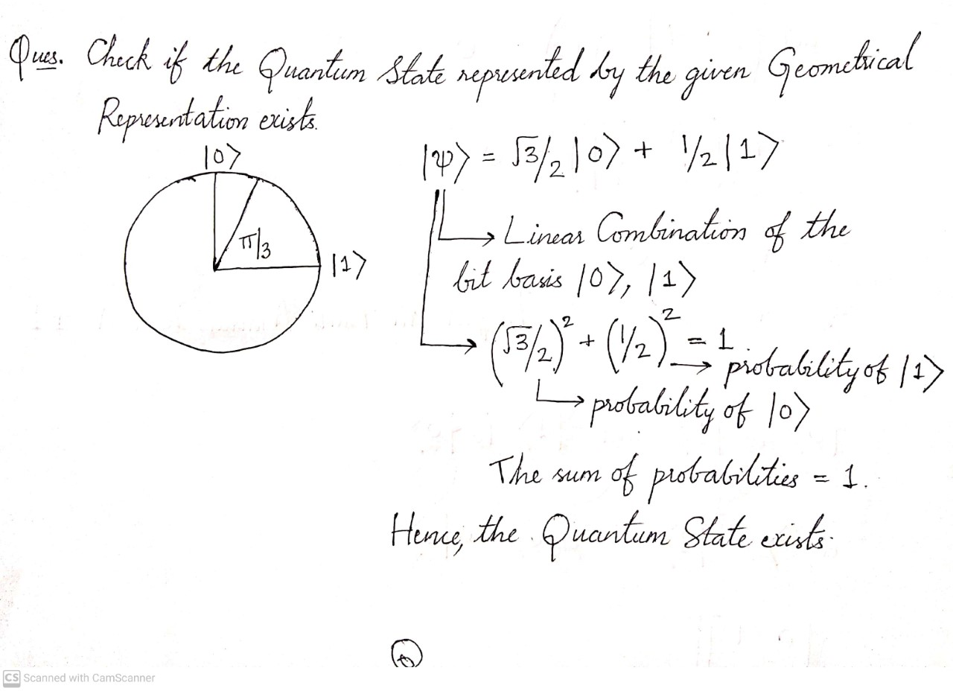

Slide 12
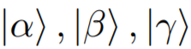
Vector Space in Quantum Computing
A Vector Space consists of Quantum States (Vectors) – together with a set of Scalars – a, b, c (belonging to Complex Numbers). It is closed under two operations:
Vector Addition
Scalar Multiplication

Slide 13
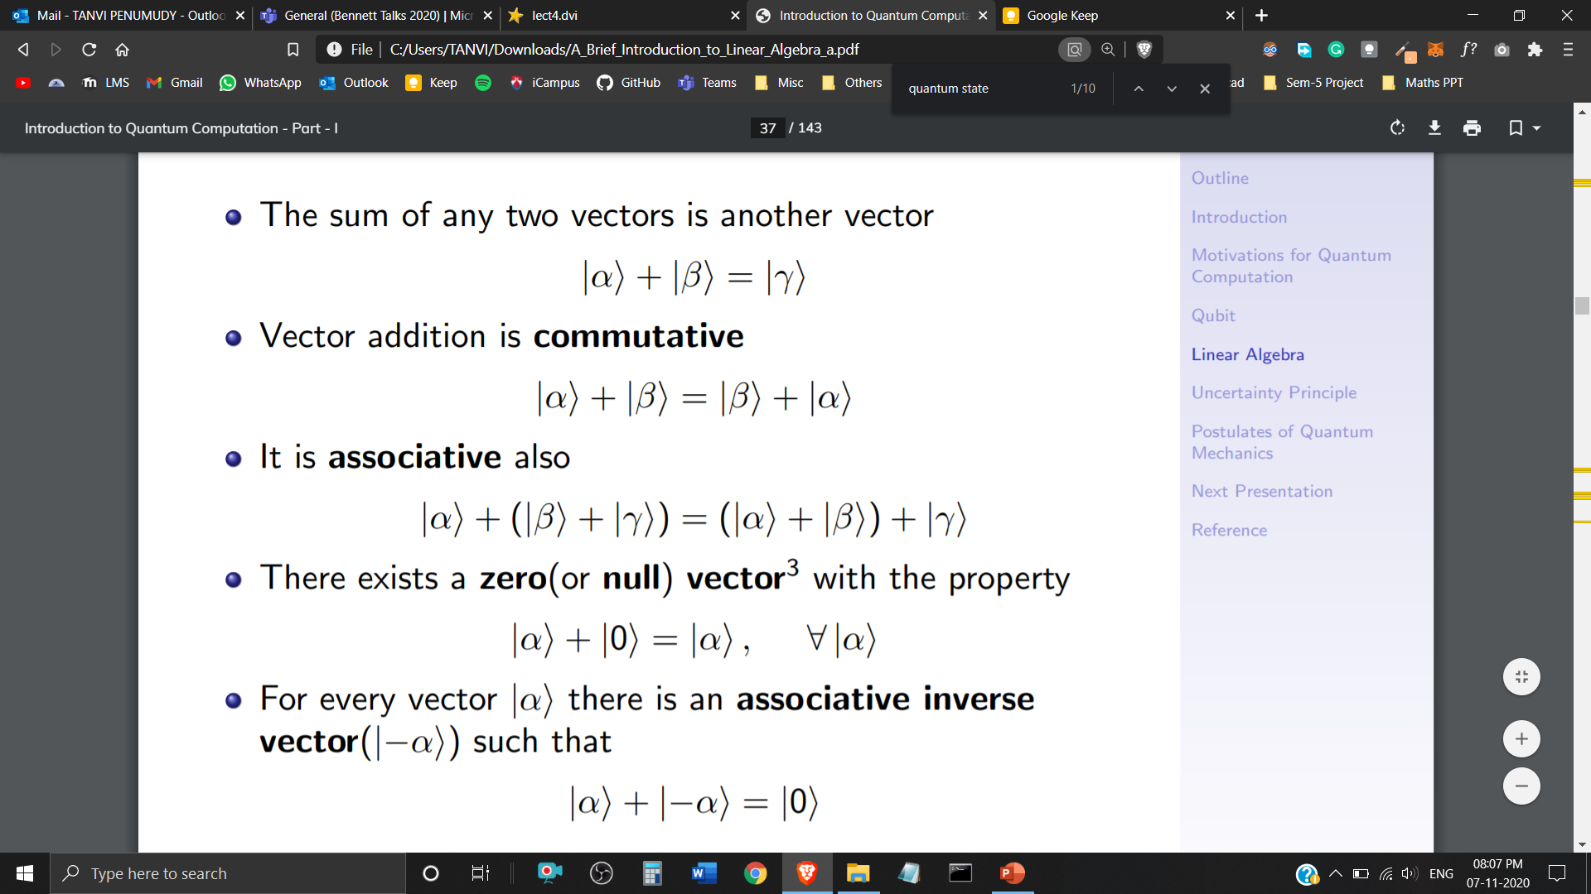
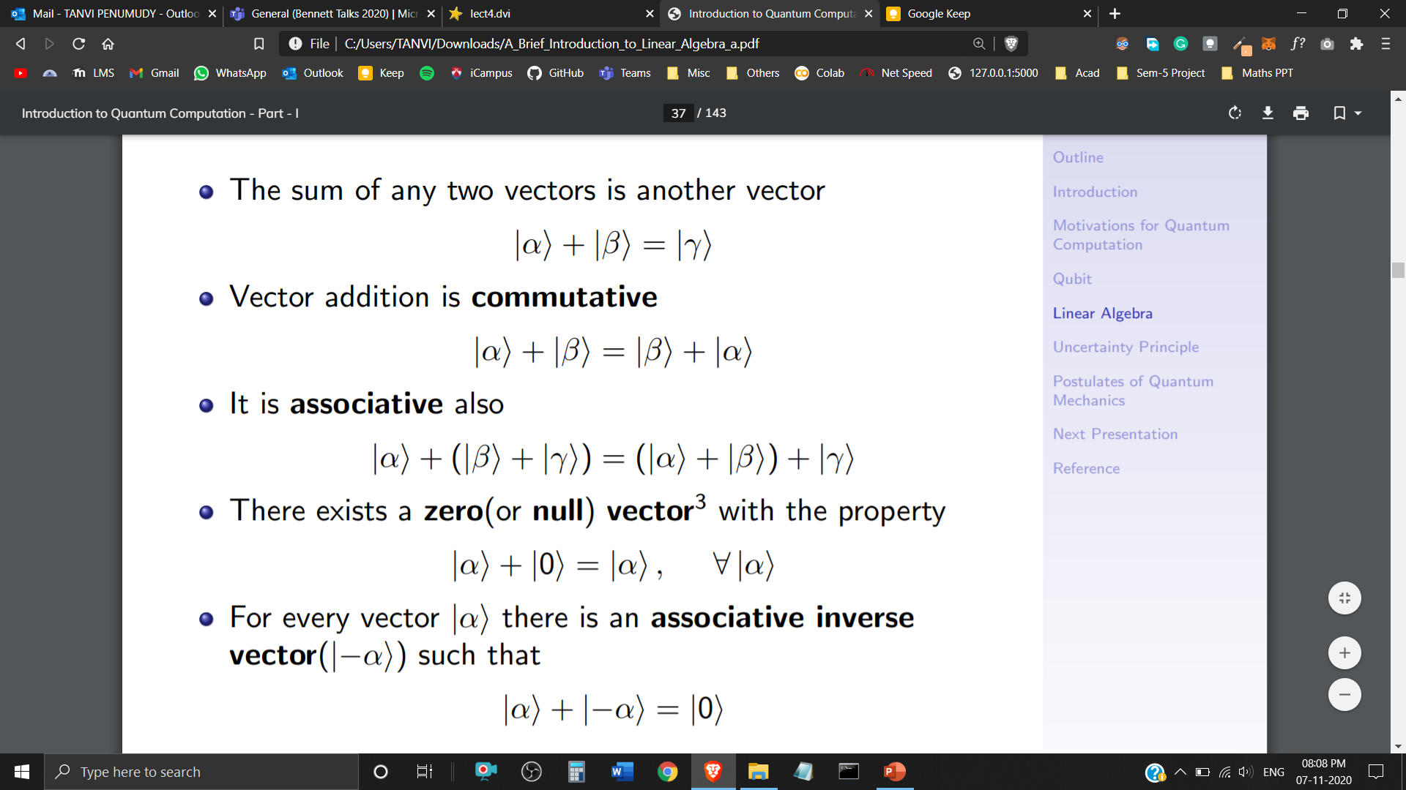
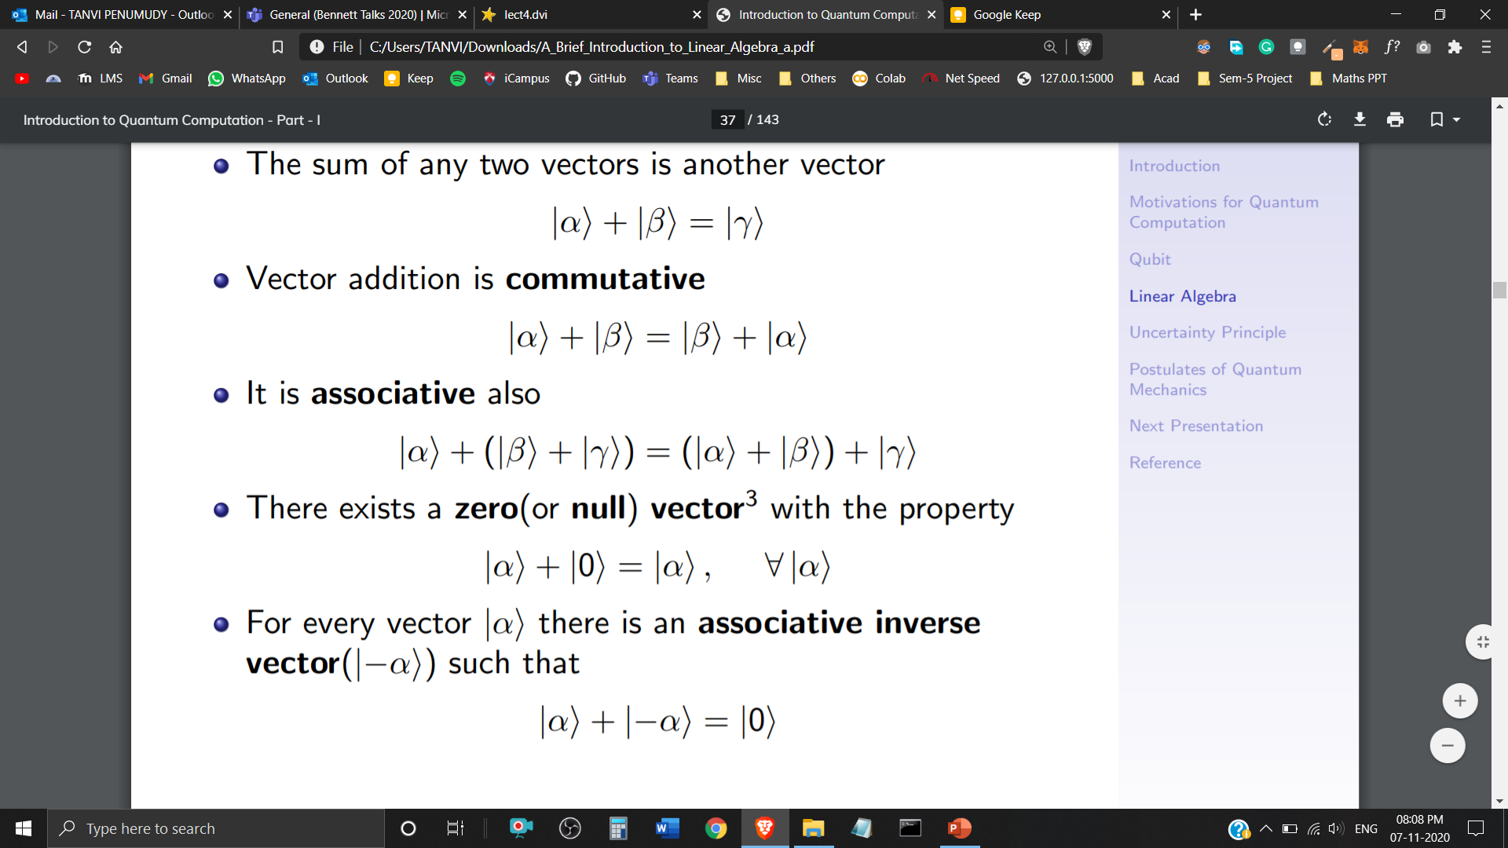
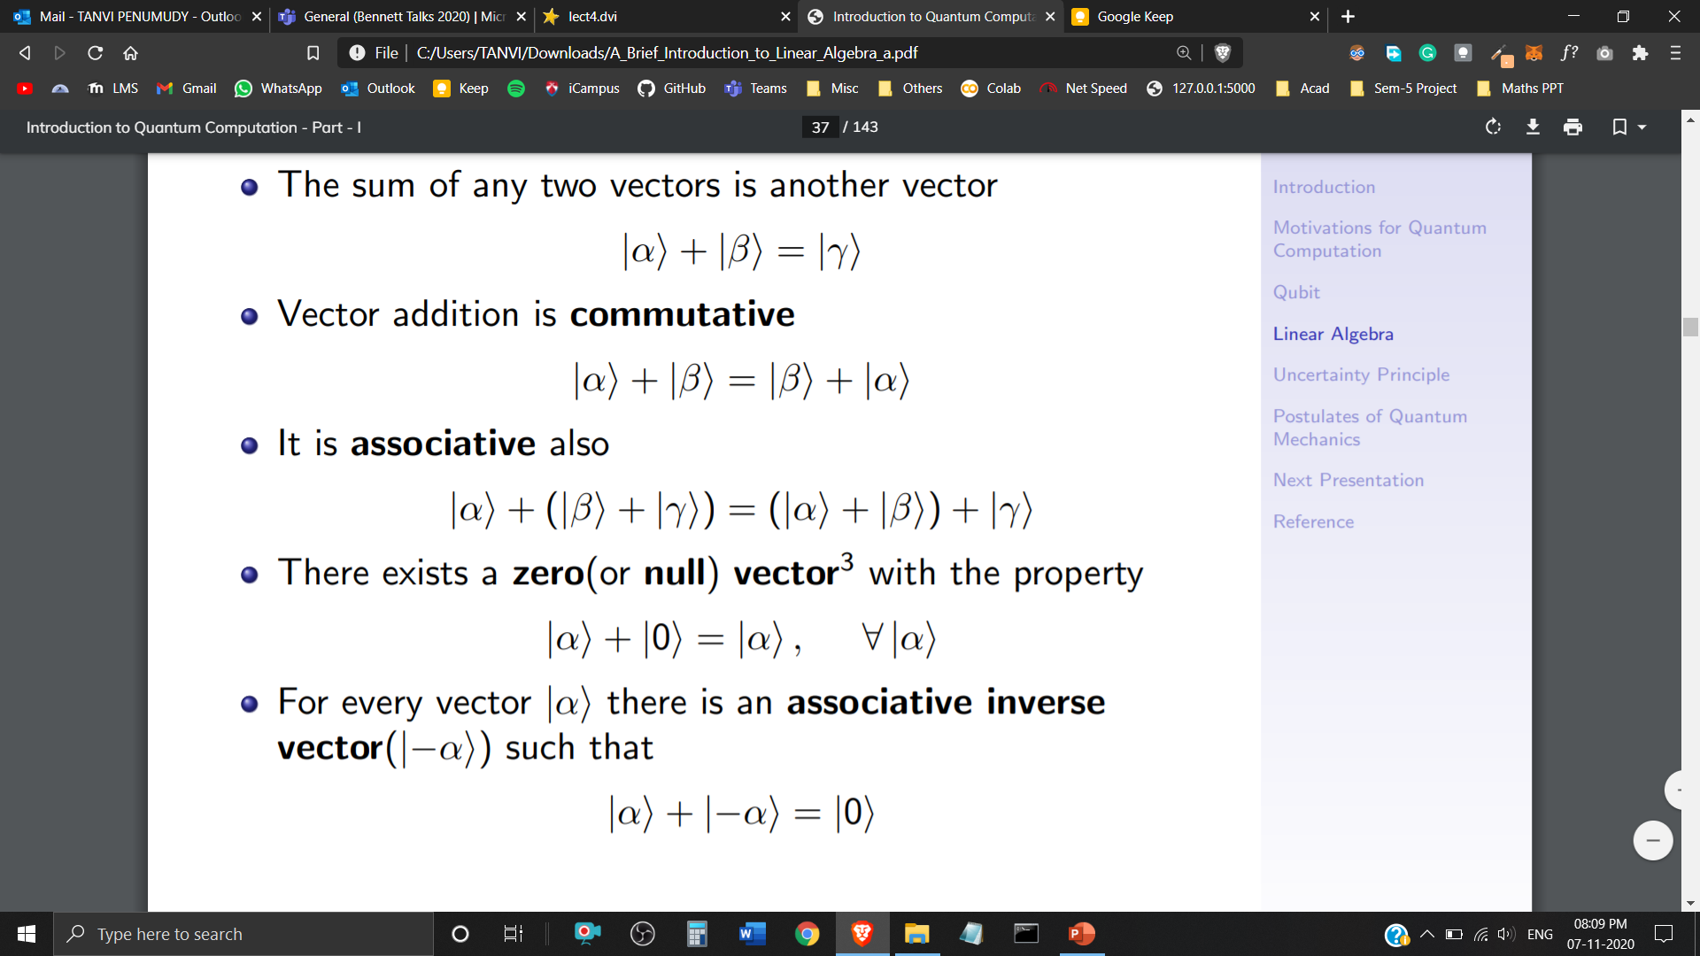

Vector Addition
Closure Property
Commutative Property
Associative Property
Additive Identity
Additive Inverse

Slide 14
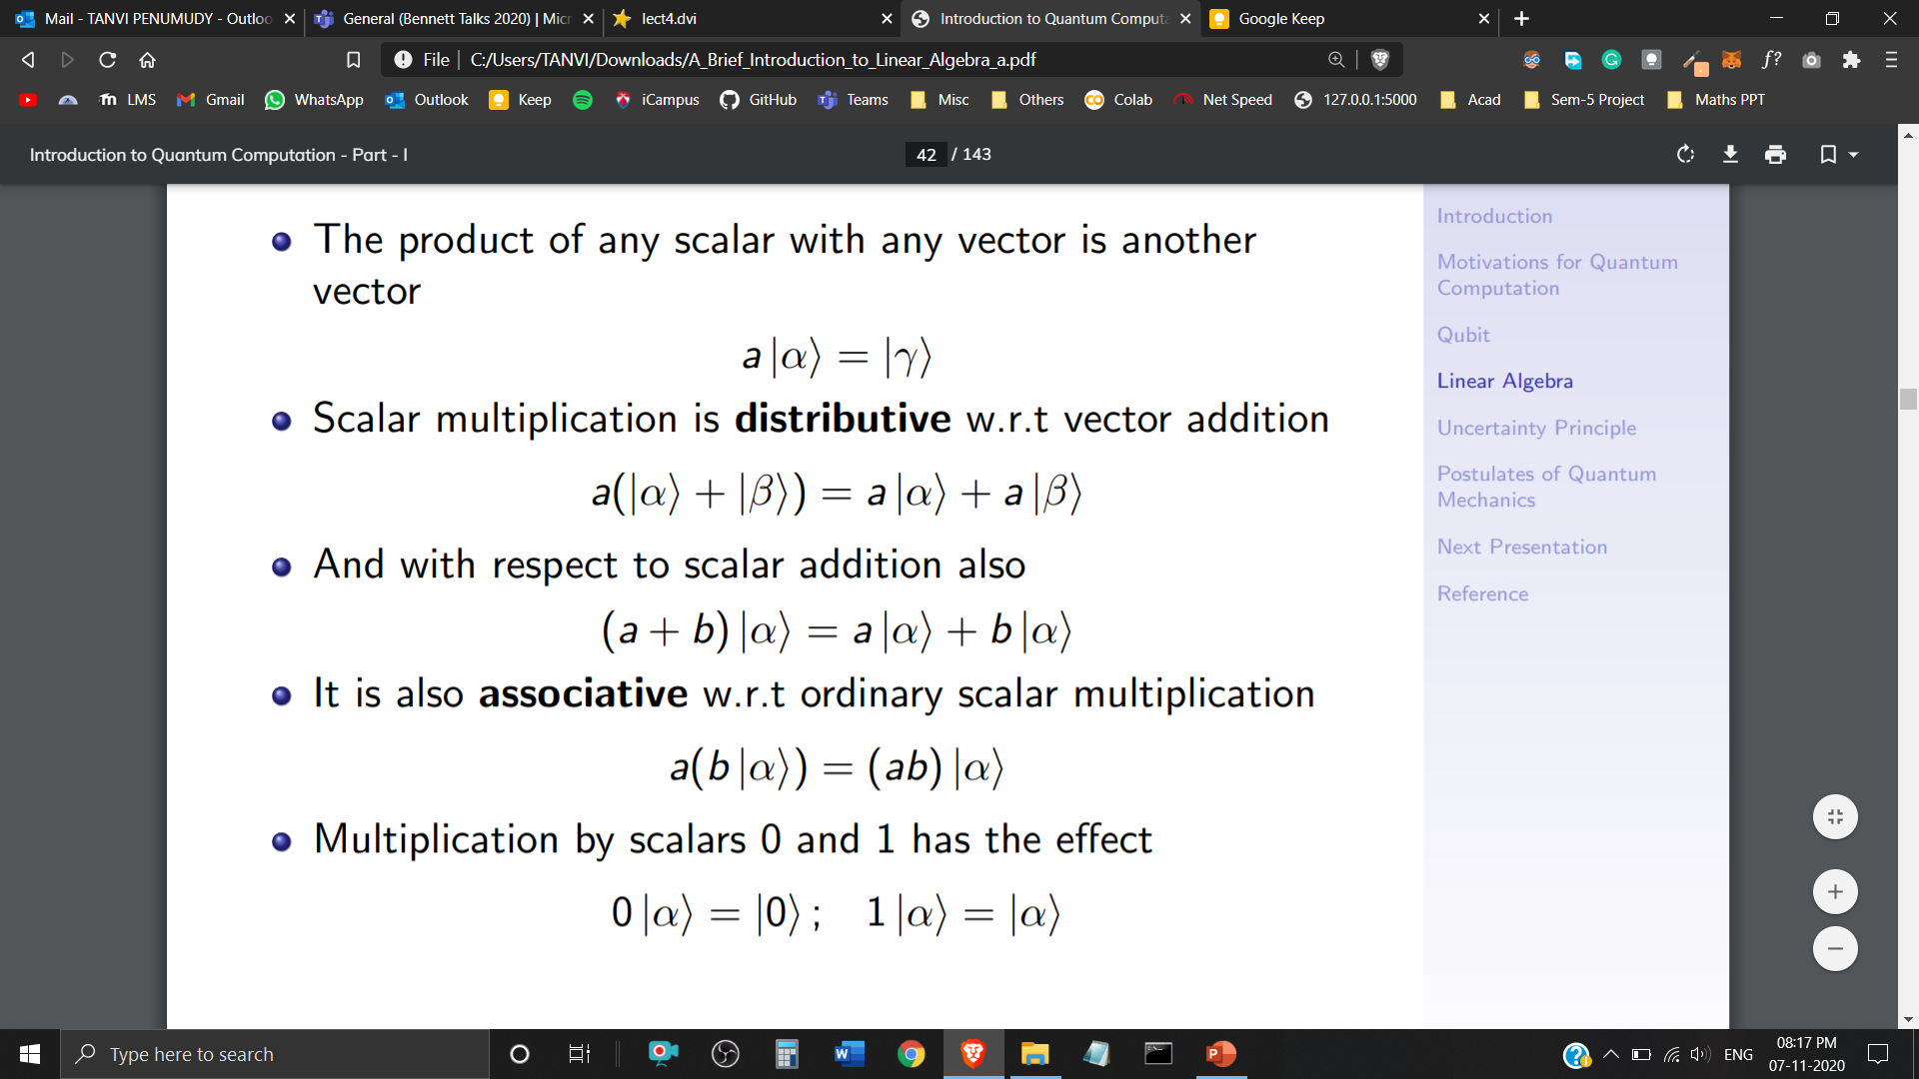



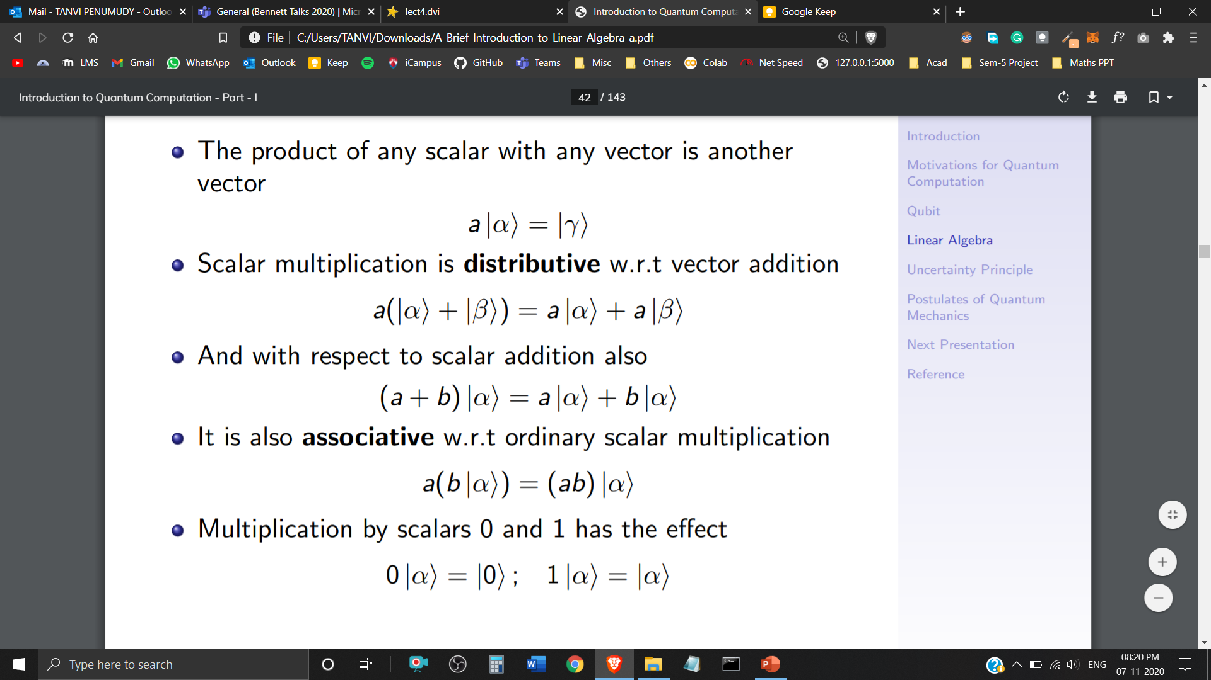
Scalar Multiplication
Closure Property
Distributive w.r.t Vector Addition
Distributive w.r.t Scalar Addition
Associative w.r.t Ordinary Scalar Multiplication
Multiplication with Scalars 0 and 1

Slide 15
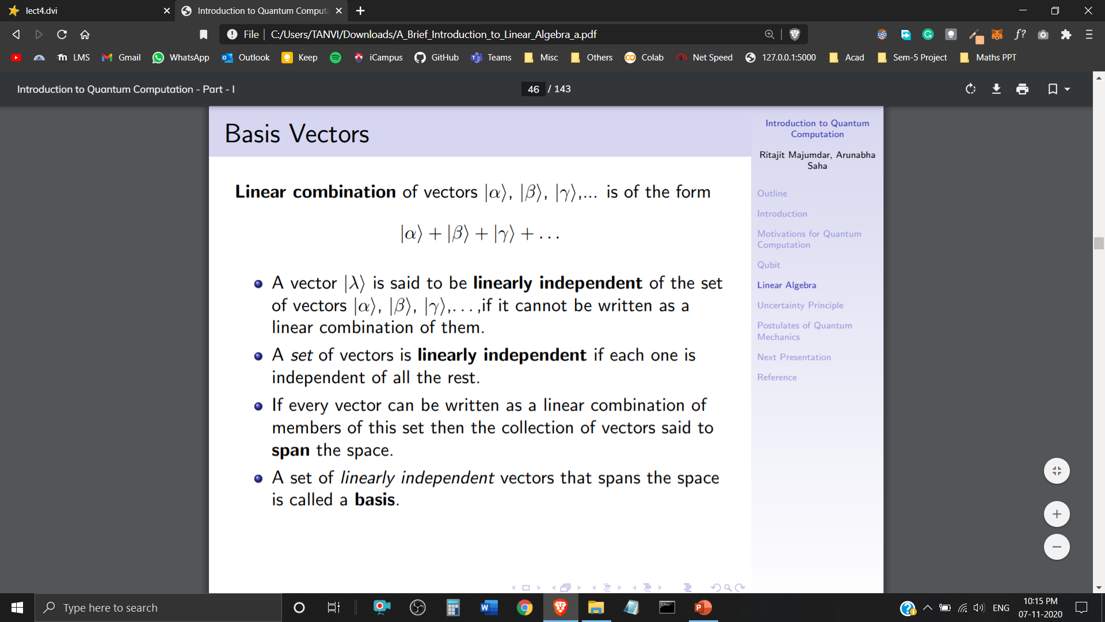

Basis
Linear Combination of Quantum States is in the form of
A Quantum State is said to be linearly independent of the set of Quantum States , if it cannot be written as a Linear Combination of them.
If every Quantum State can be written as a Linear Combination of this set, then the collection of Quantum States said to Span the space.
A set of Linearly Independent Quantum States that span the space is called a Basis.

Slide 16
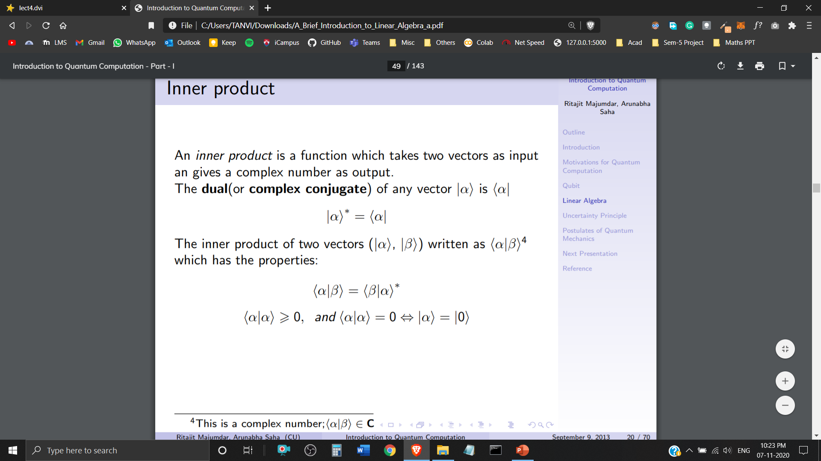
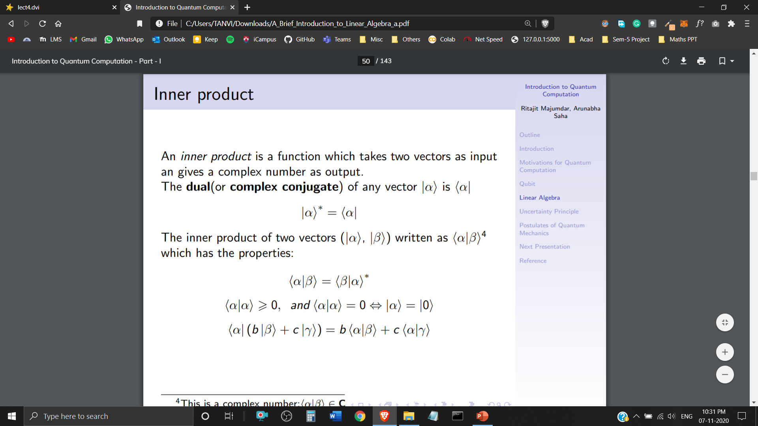

Inner Product
An inner product is a function which takes two Quantum States as input and gives a Complex Number as output.
The Dual (or Complex Conjugate) of any Quantum State (ket notation – column vector) is (bra notation – row vector)
The inner product of two Quantum States is written as

Slide 17
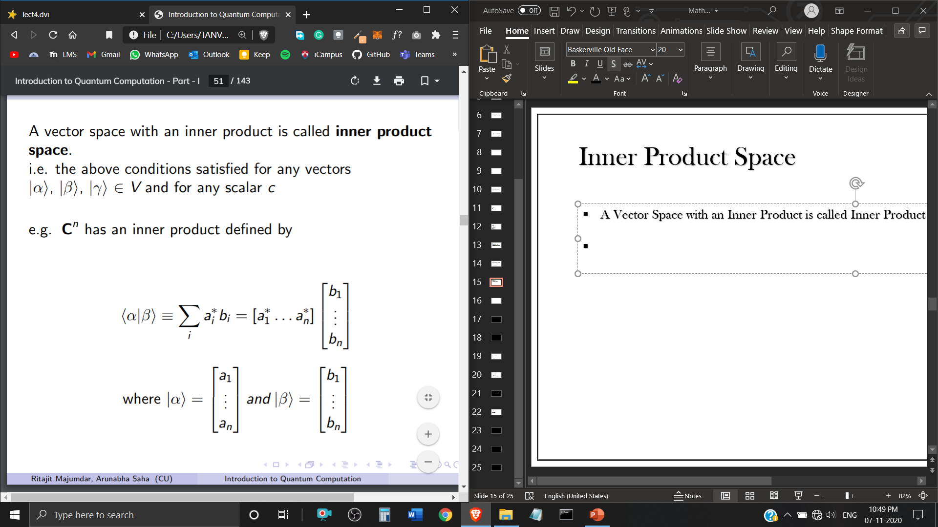
Inner Product Space
A Vector Space with an Inner Product is called Inner Product Space.
has an inner product defined by
where,

Slide 18
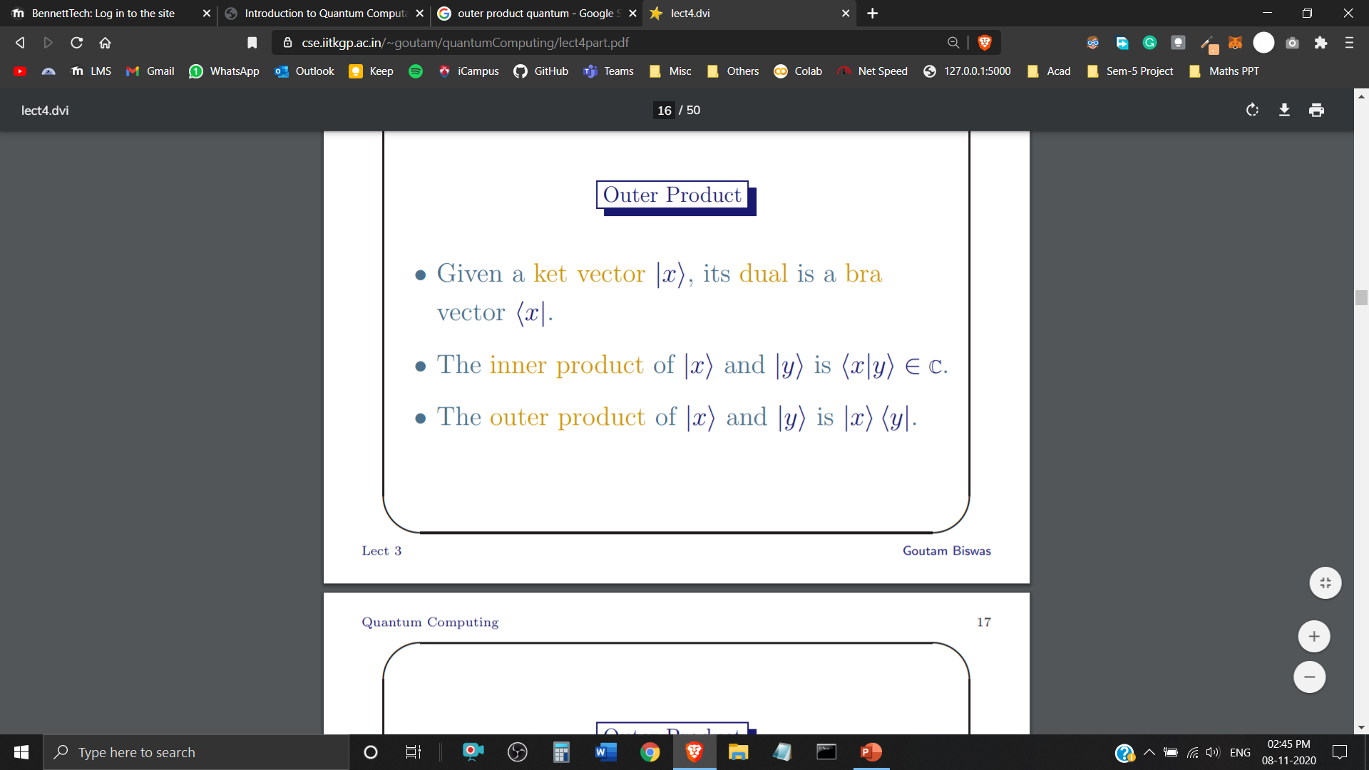
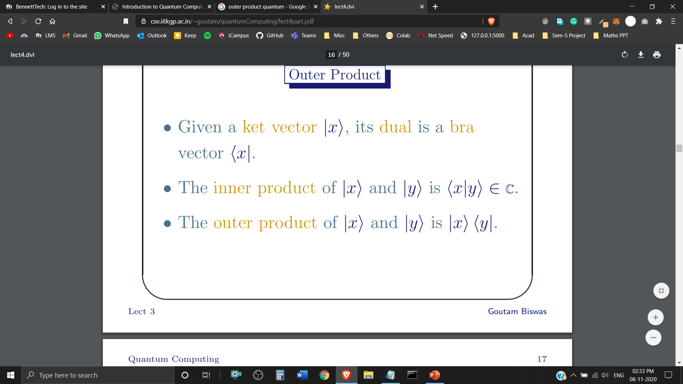
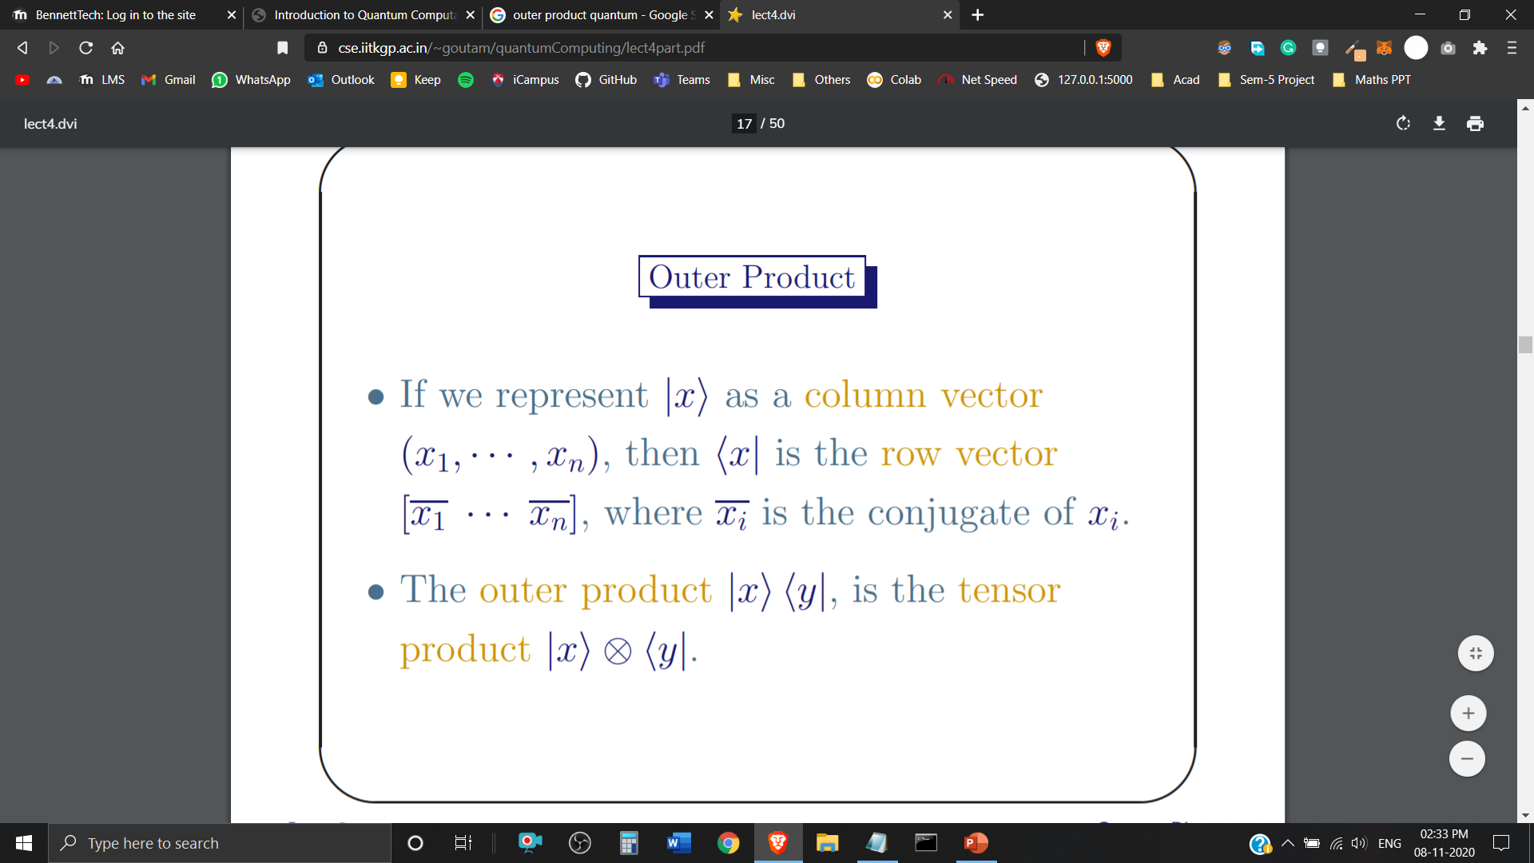
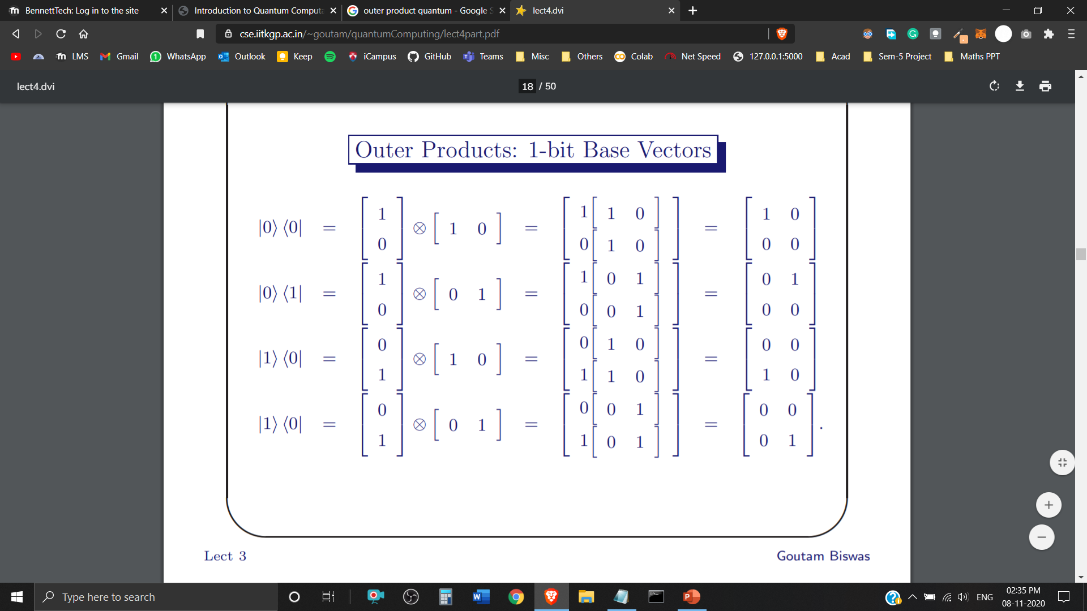
Outer Product

Slide 19
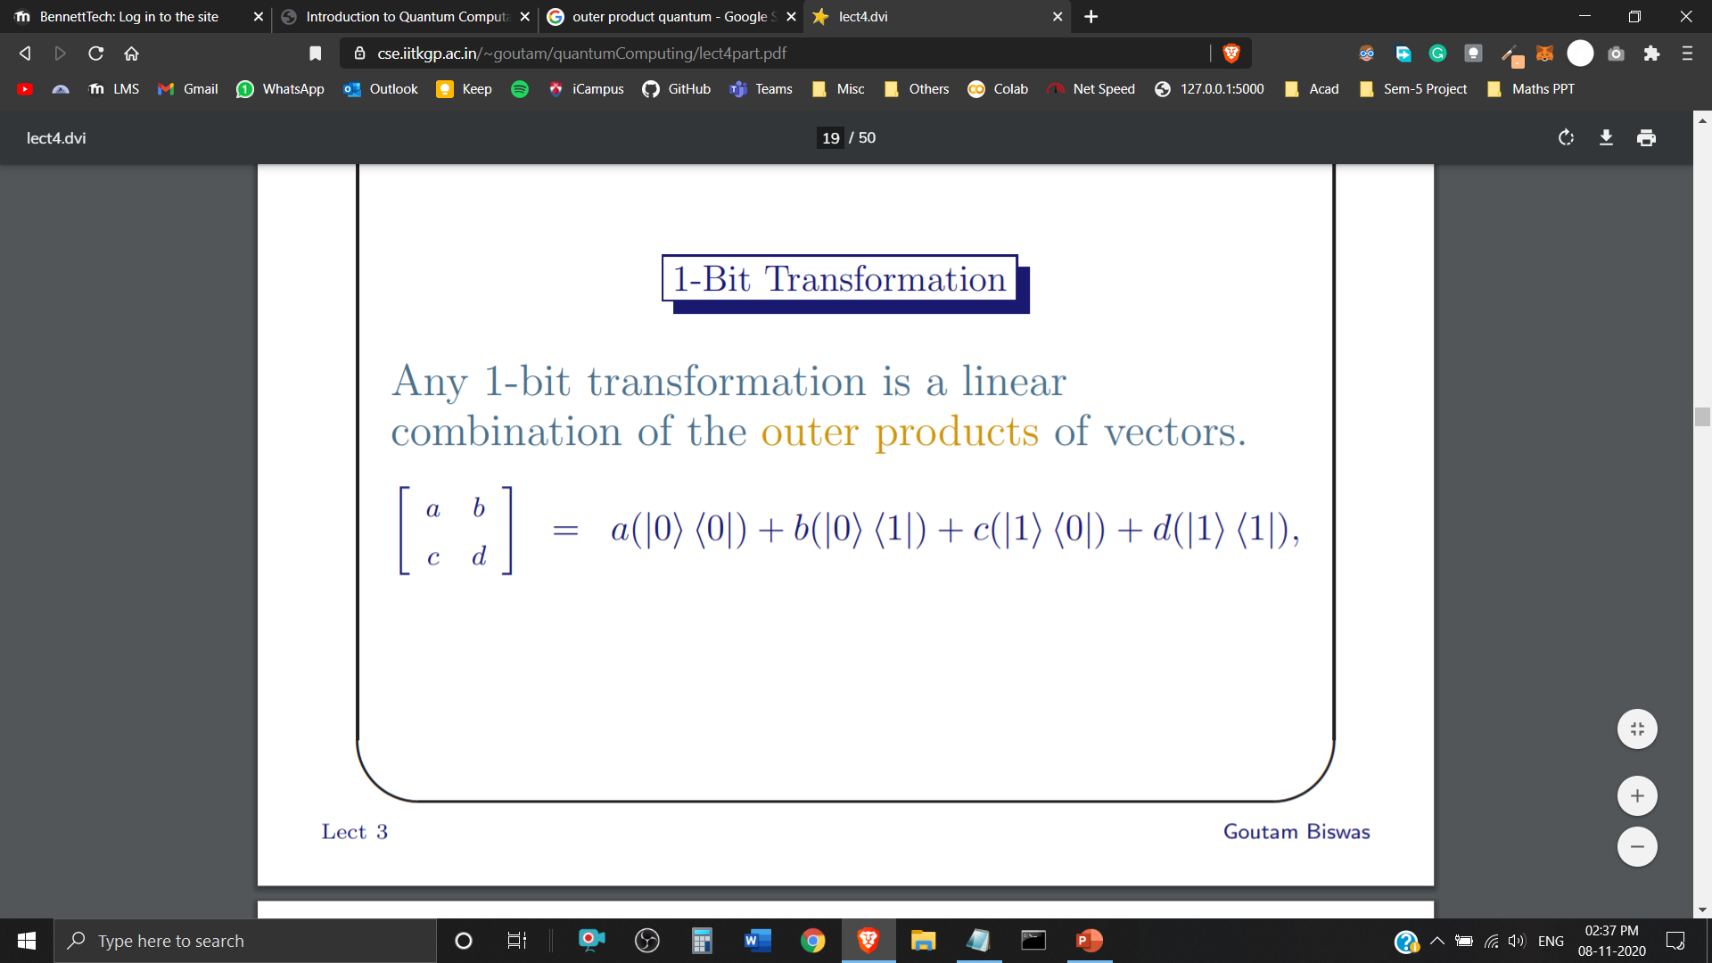
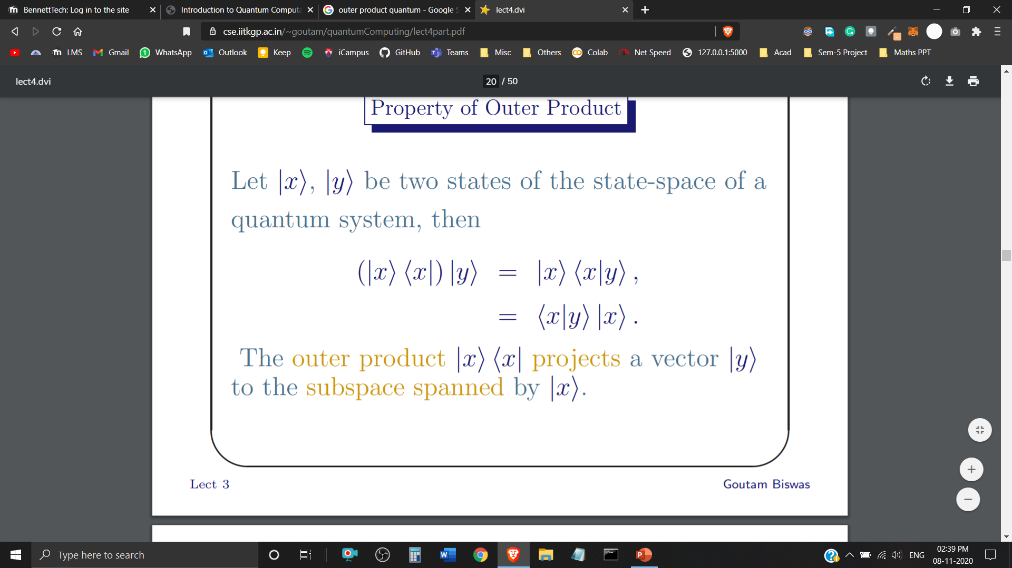
Outer Product
1-Bit Transformation (linear combination of the outer products of vectors)
Property of Outer Product

Slide 20
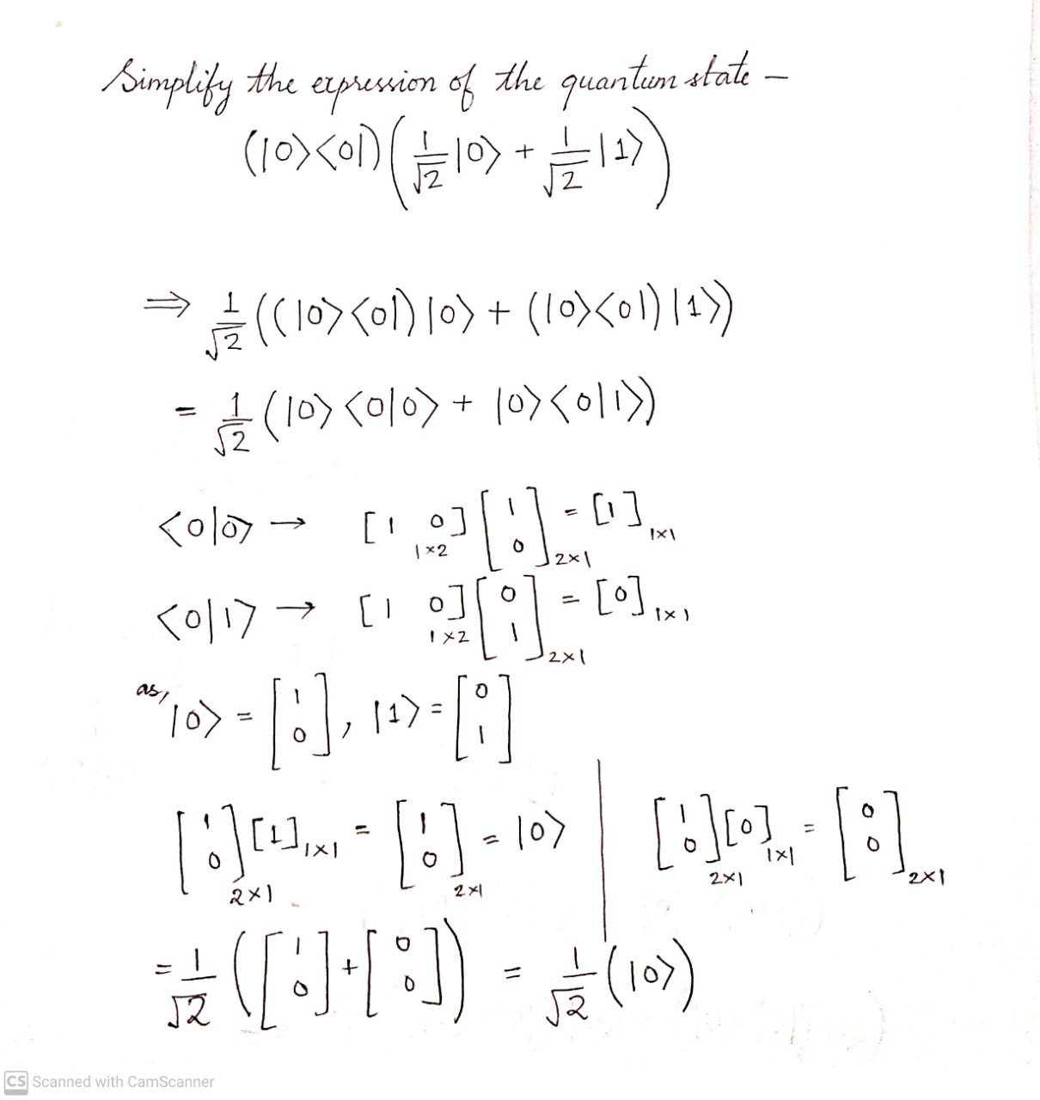
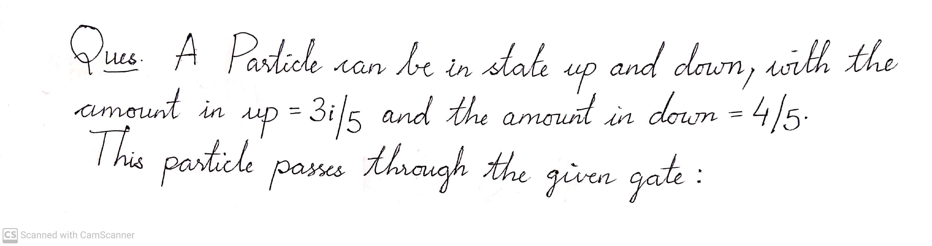
Optimization of Quantum State Expressions plays a critical role in Quantum Computation and Quantum Information Processing.

Slide 21
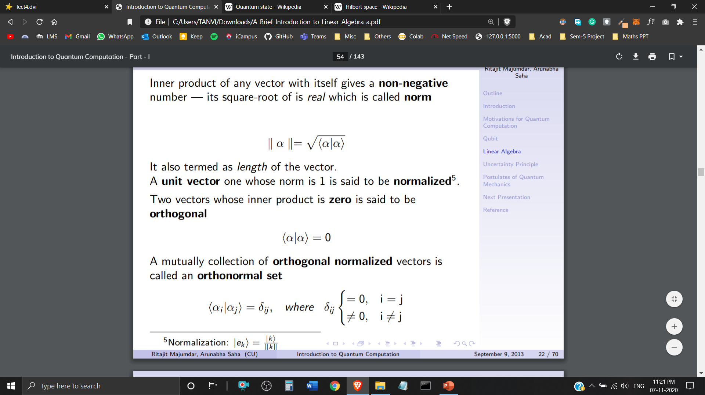
Orthonormal Set
Inner product of any Quantum State with itself gives a Non-negative number – its square root of id real which is called norm. (Also termed as Vector Length)
A Quantum State with Norm 1 (Unit Vector) is said to be Normalized.
Two Quantum States with Inner Product zero are said to be Orthogonal.
A Mutual Collection of Orthogonal Normalized Quantum States is called an Orthonormal Set.

Slide 22
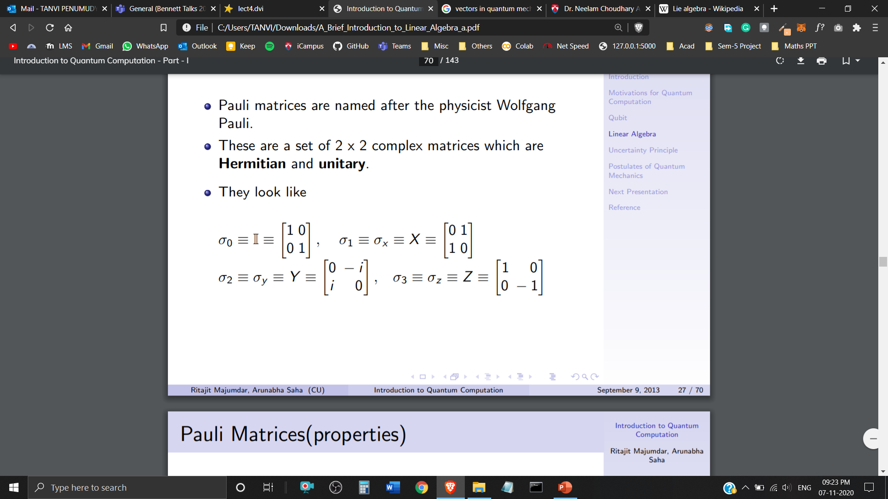
Pauli Matrices
Pauli Matrices are named after the physicist Wolfgang Pauli.
These are a set of 2 x 2 complex matrices which are Hermitian and Unitary.

Slide 23
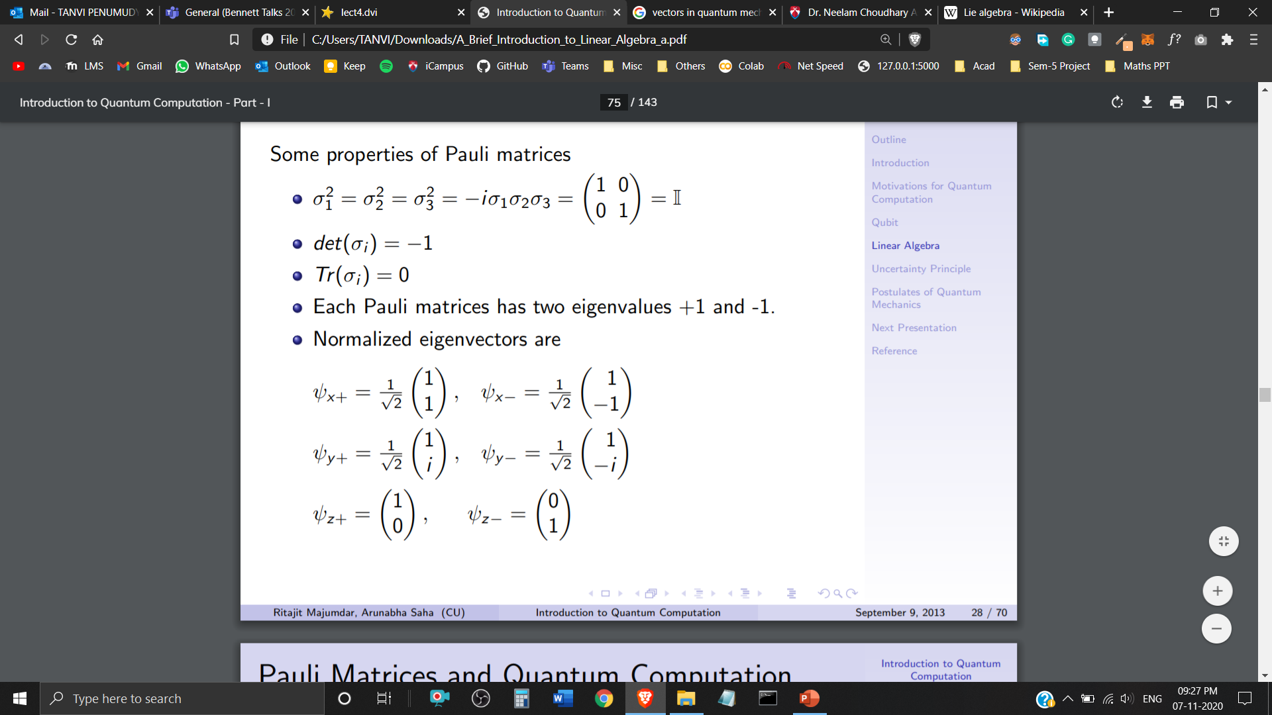
Properties of Pauli Matrices
Each Pauli Matrix has eigenvalues +1 and -1
Normalised Eigenvectors are

Slide 24
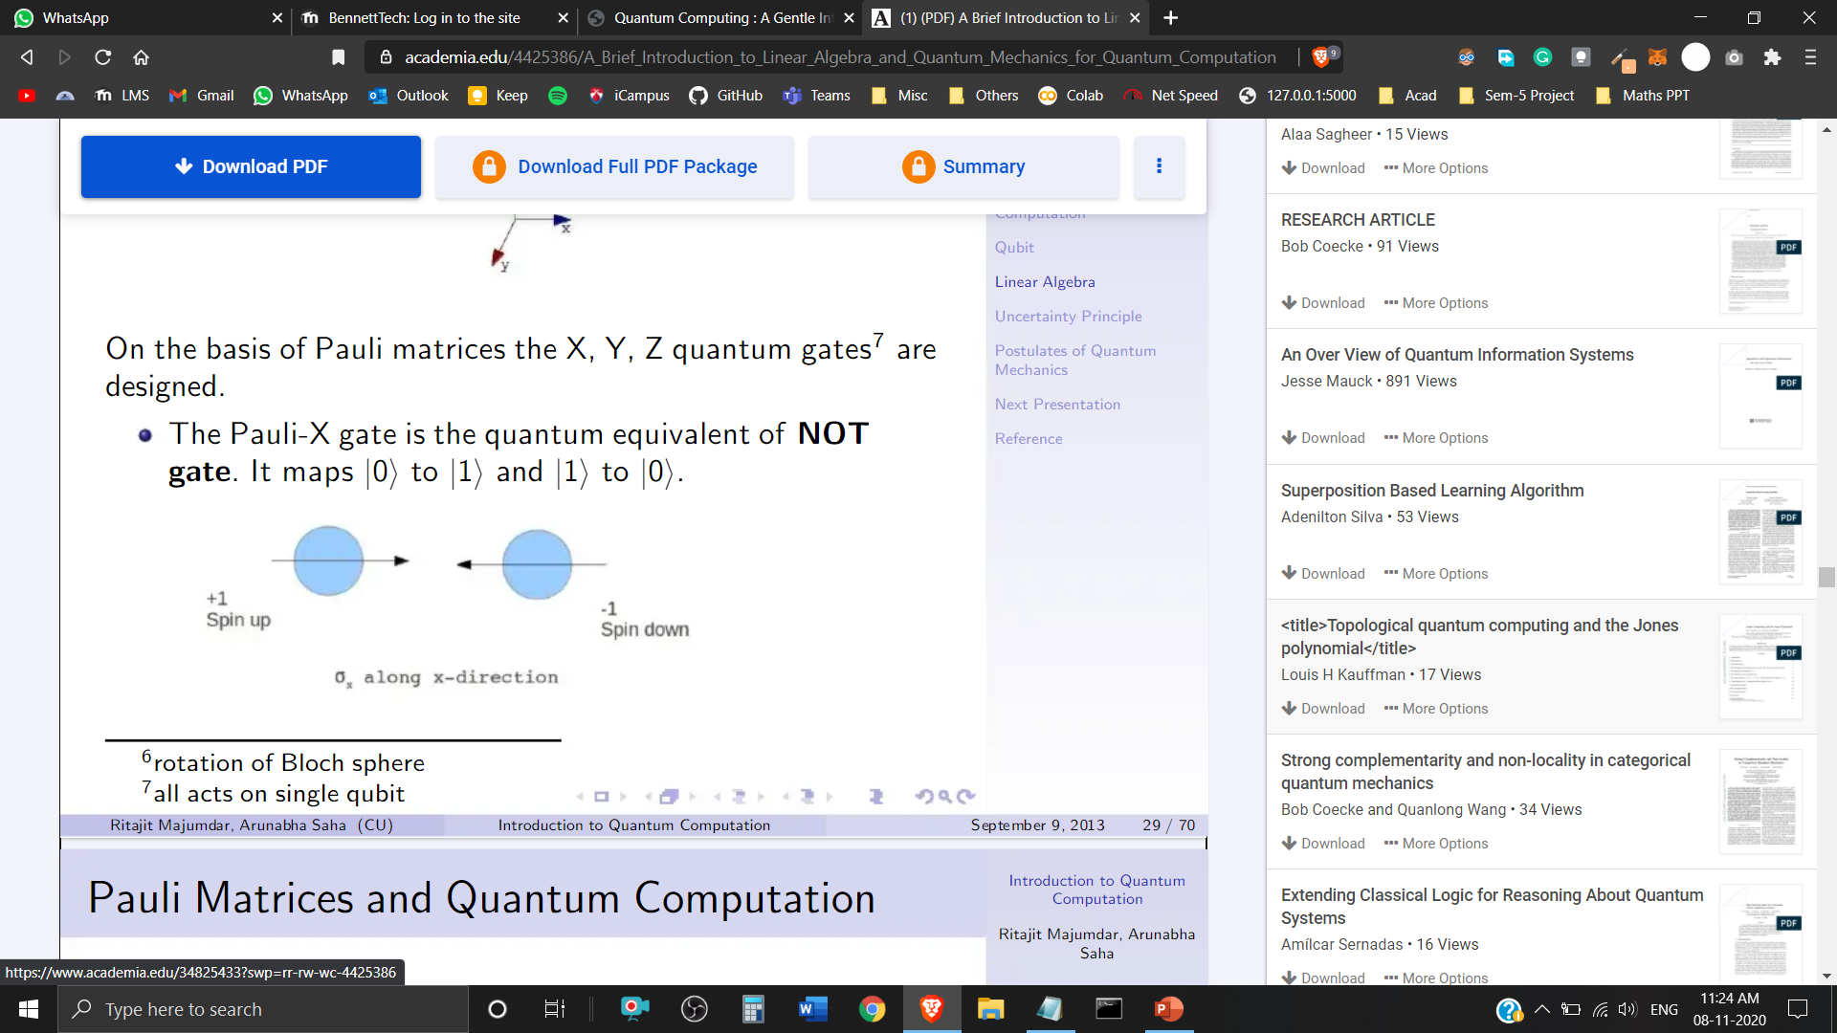
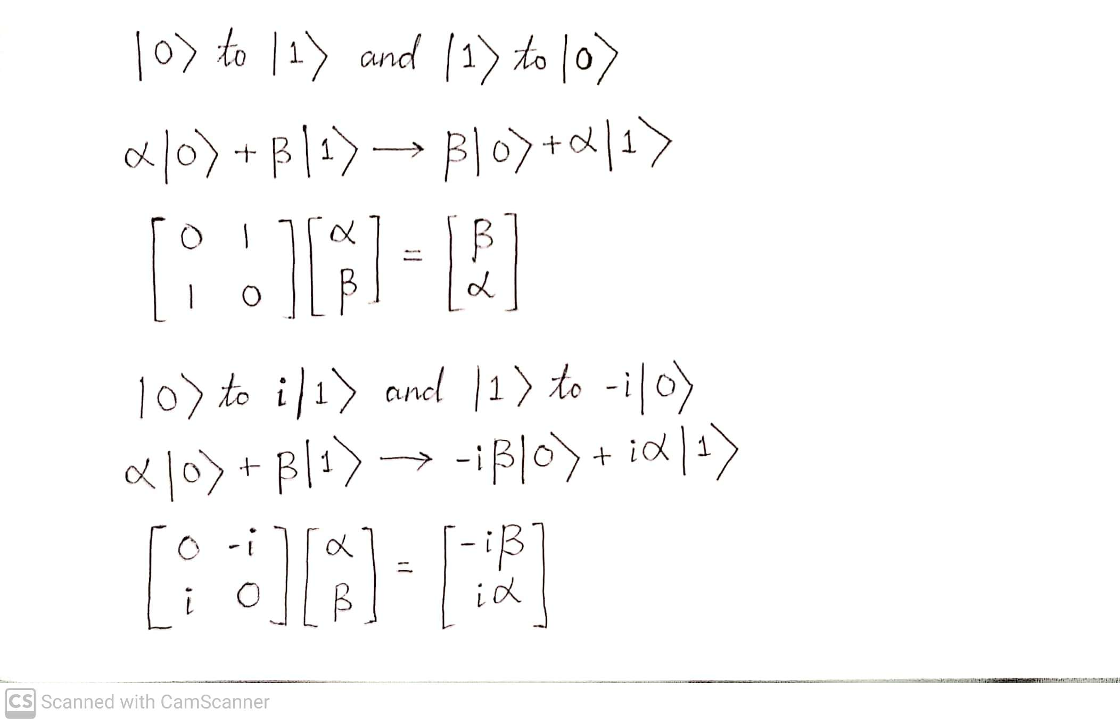
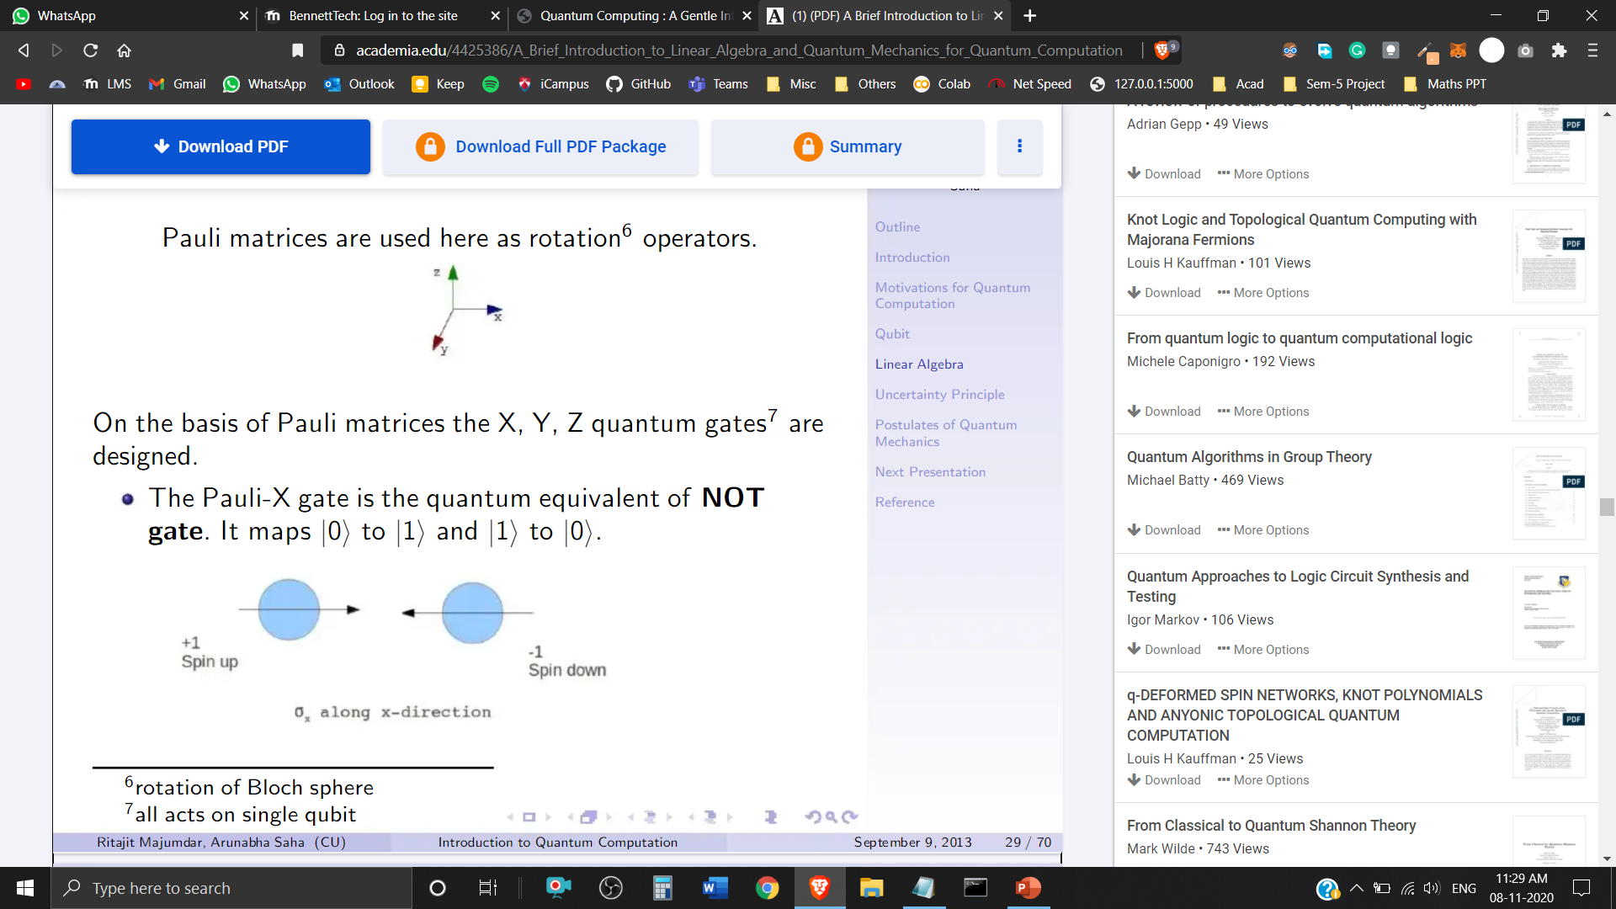
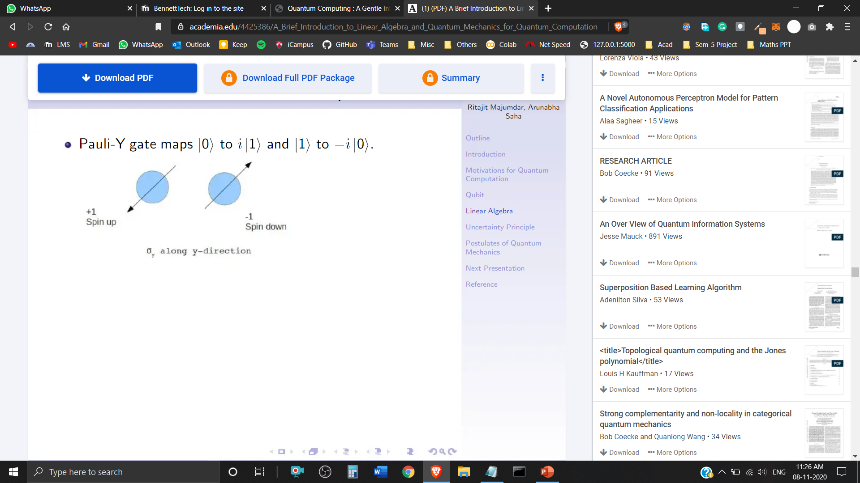
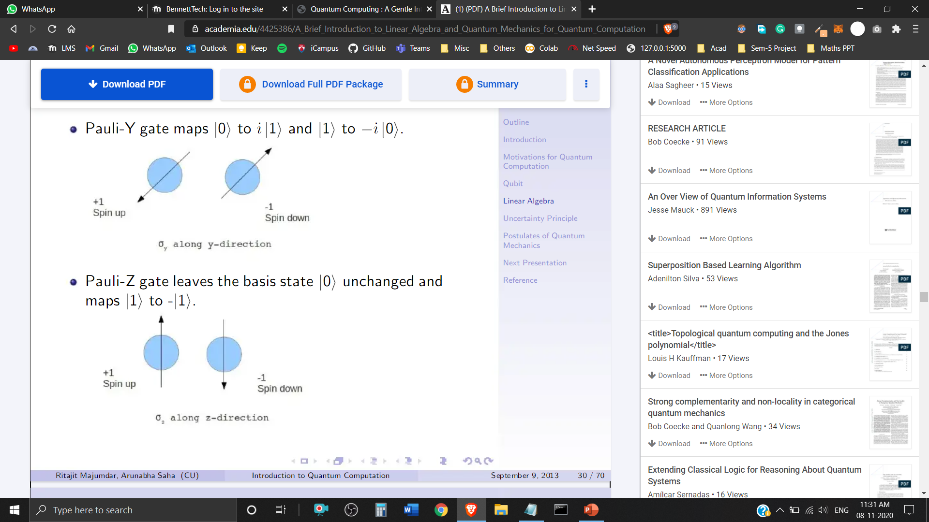
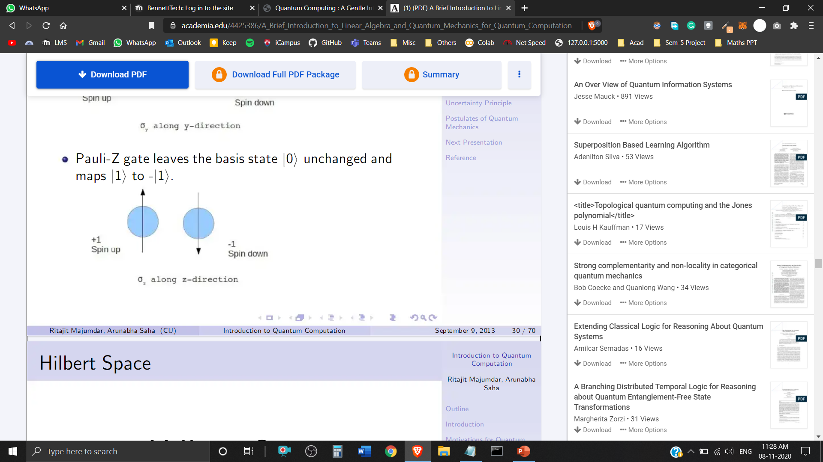
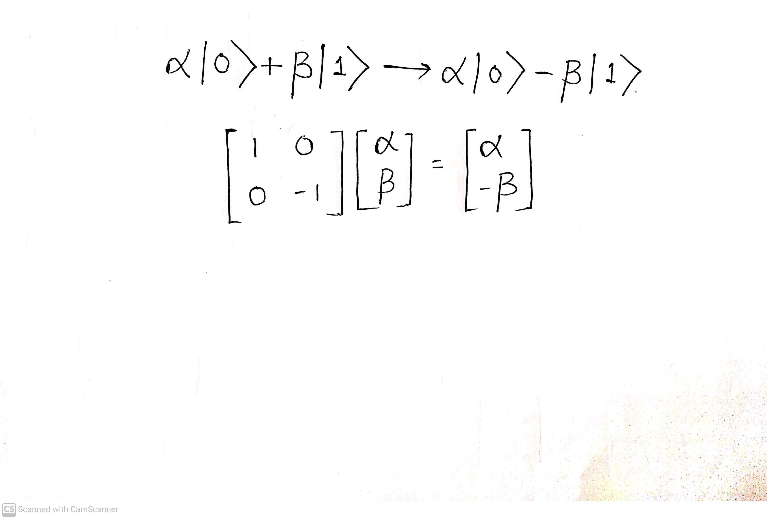
Pauli Transformations
The Pauli-X gate is the quantum equivalent of NOT gate. It maps
The Pauli-Y gate maps
The Pauli-Z gate leaves the basis state unchanged and maps

Slide 25

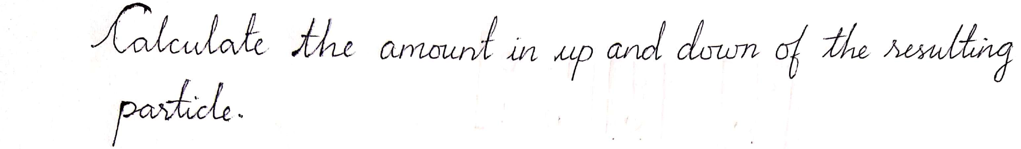
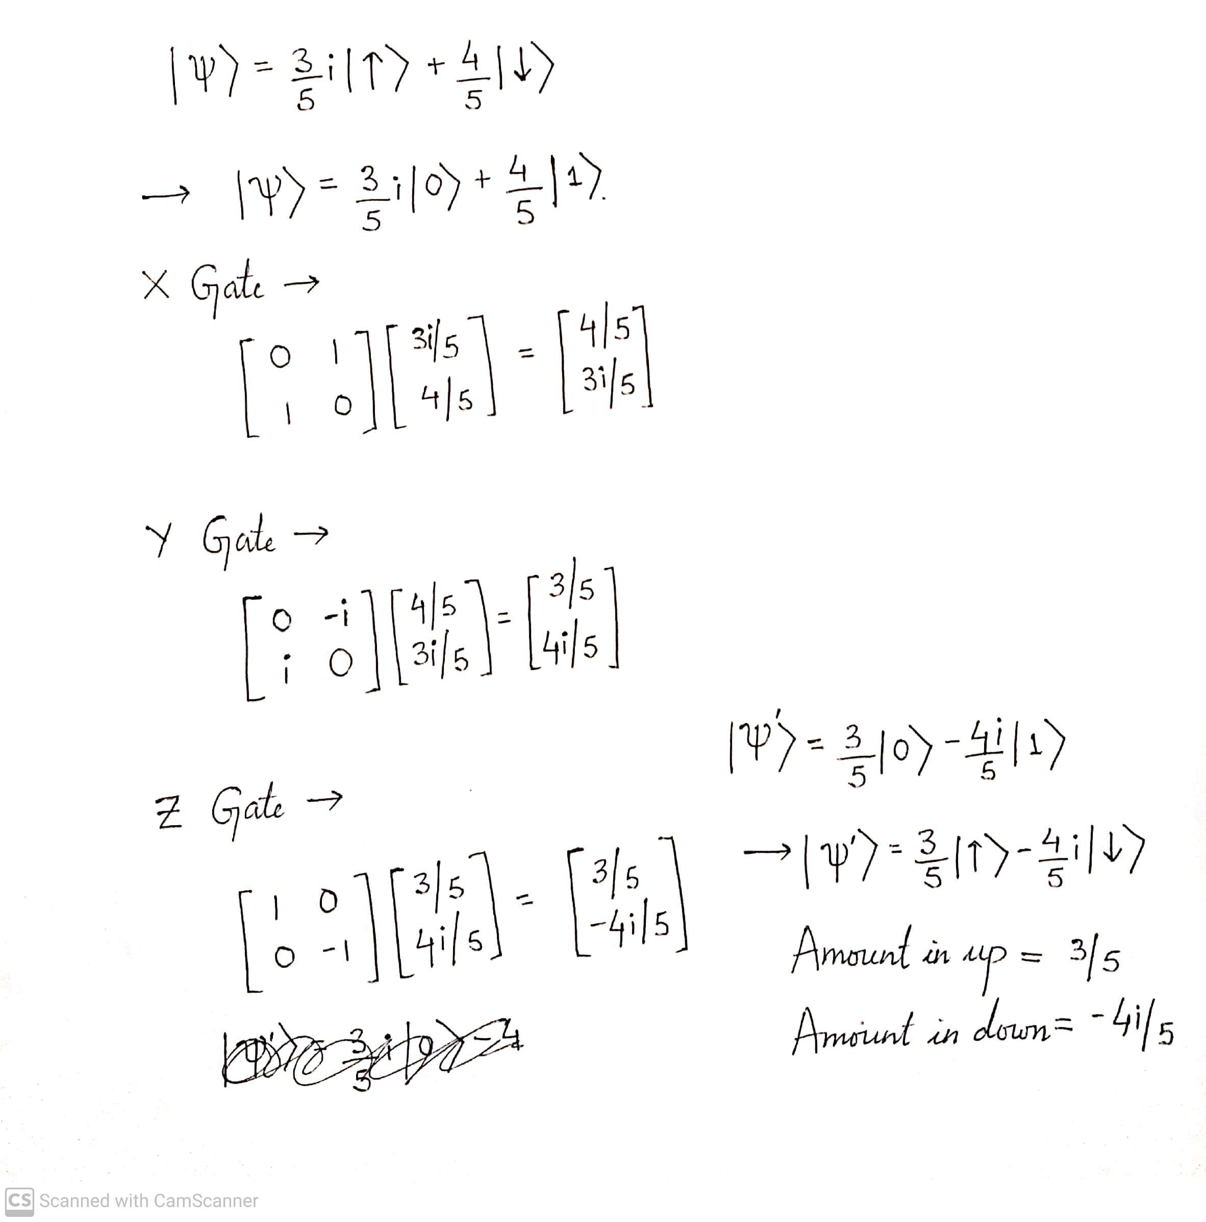

Slide 26

Bloch Sphere
In quantum mechanics and computing, the Bloch sphere is a geometrical representation of the pure state space of a two-level quantum mechanical system (qubit), named after the physicist Felix Bloch.

Slide 27
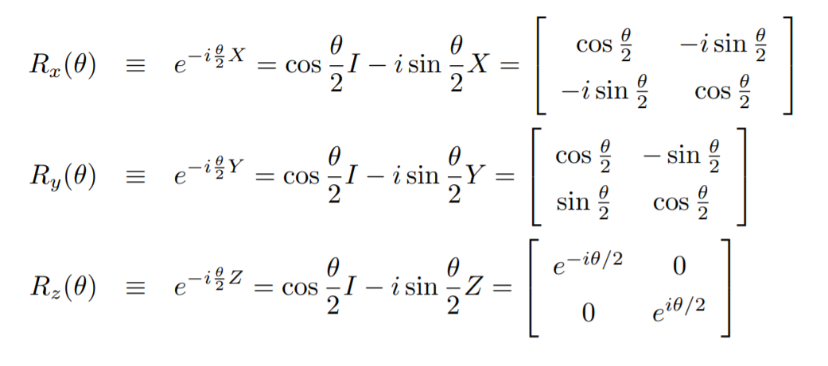
Rotation Operators on Bloch Sphere
When the Pauli X, Y and Z matrices are exponentiated, they give rise to the rotation operators, which rotate the Bloch vector about the ˆx, ˆy and ˆz axes, by a given angle θ:

Slide 28
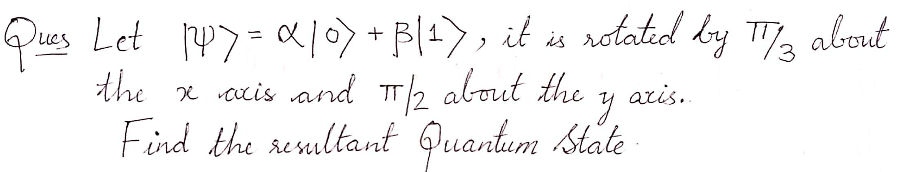
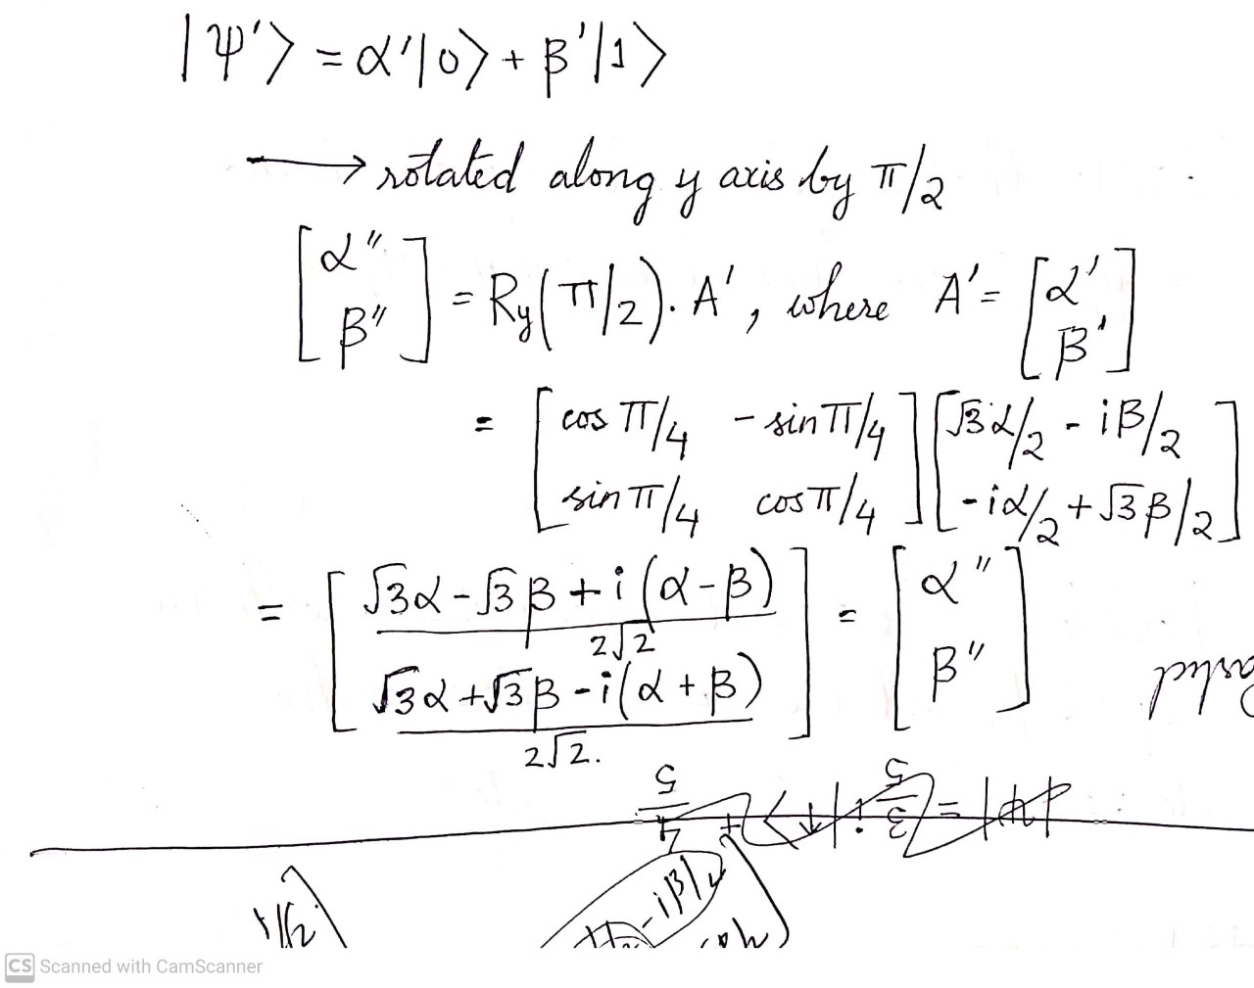
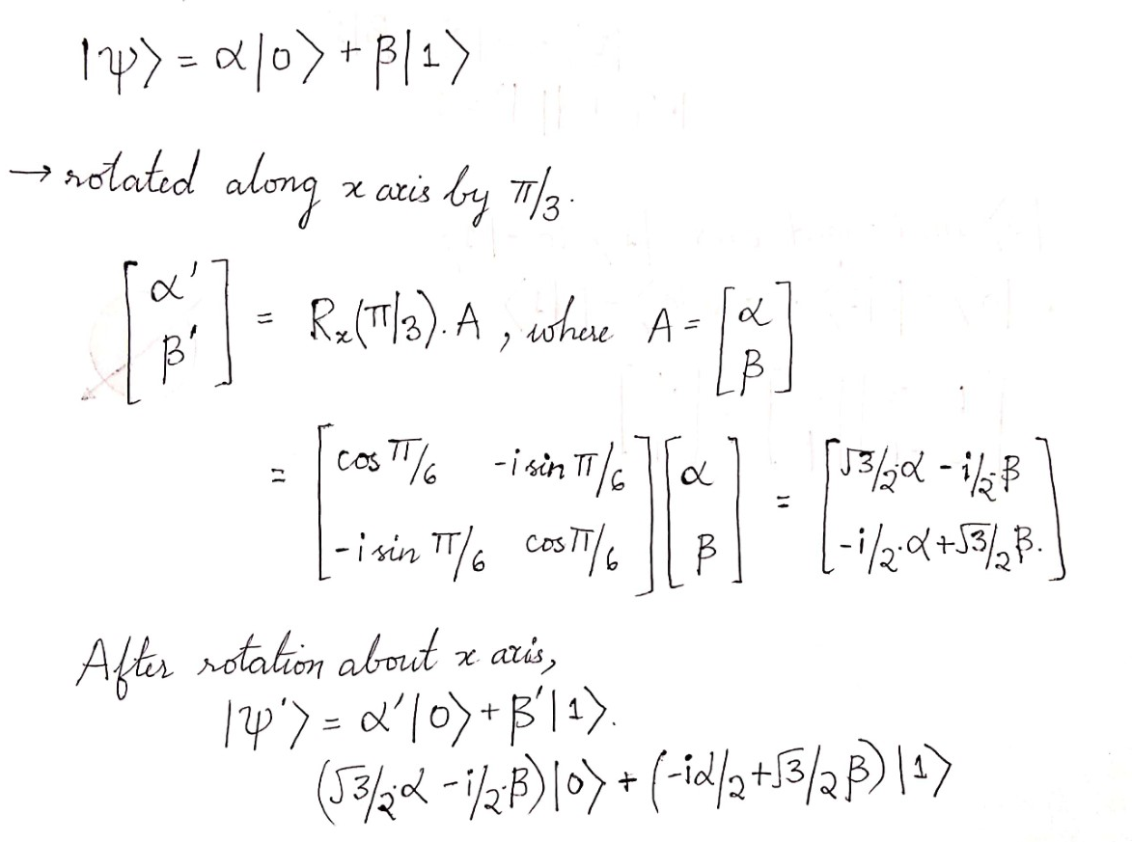
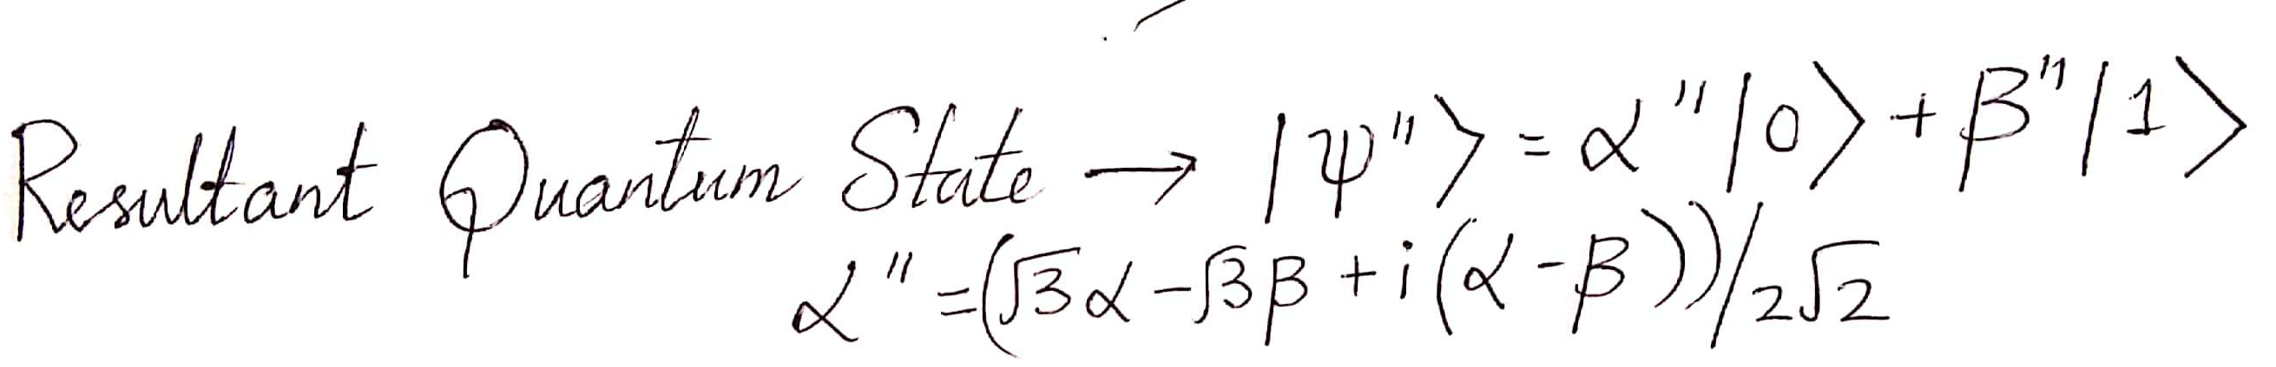


Slide 29
Quantum Entanglement
The term ‘Entanglement’ means that the two members of a pair exist in a single quantum state.
Changing the state of one of the qubits will instantaneously change the state of the other one in a predictable fashion.
This property is used as a resource in Quantum Computing such as
○ Super dense coding
○ Quantum Teleportation
○ Error Correction

Slide 30


Slide 31
Hilbert Space
Wave functions exist in the Hilbert Space

Slide 32

Hilbert Space
The Mathematical Concept of Hilbert Space has been named after David Hilbert.
Hilbert Space is an abstract vector space with inner product defined in it, that allow the length and angle to be measured.
Hilbert Space must be complete.
Infinite Dimensional Inner Product Space

Slide 33

Observables
A System ‘Observable’ is a measurable operator, where the property of the system state can be determined by some sequence of physical operations.
In Quantum Mechanics, each ‘Dimensional Variable’ – Position, Translational Momentum, Orbital Angular Momentum, Energy, Spin, etc. is associated with a Hermitian Operator that acts on the state of the quantum system, whose Eigenvalues correspond to the possible values of the dynamical variable.
Let be an Eigenvector of the Observable ‘A’ with Eigenvalue a, and exists in a D-Dimensional Hilbert Space, then
This equation states that if a measurement of the Observable A is made while the system is in Quantum State, then the observed value of that measurement must return the eigenvalue a with certainty.

Slide 34

Hermitian Operator
Self-Adjoint Operator
Hermitian matrix is a square matrix with complex entries that is equal to its own conjugate transpose.
or
Eigenvalues of Hermitian operators are real.
Eigenfunctions belonging to distinct eigenvalues are orthogonal.
The eigenfunctions of a Hermitian operator is complete.
Any function (in Hilbert space) can be expressed as the linear combination of them

Slide 35
Postulates of
Quantum Mechanics

Slide 36
1st Postulate: State Space
Associated to any isolated system is a Hilbert Space called the state space. The system is completely defined by the state vector, which is a unit vector in the state space.

Slide 37
2nd Postulate: Evolution
Associated to any isolated system is a Hilbert Space called the state space. The system is completely defined by the state vector, which is a unit vector in the state space.

